Slide 1

An NSS Audio-Visual
Library Presentation
The Best of the
1995 NSS Photo Salon
National Speleological Society
S919 82 Slides 3/09/2021

Slide 2
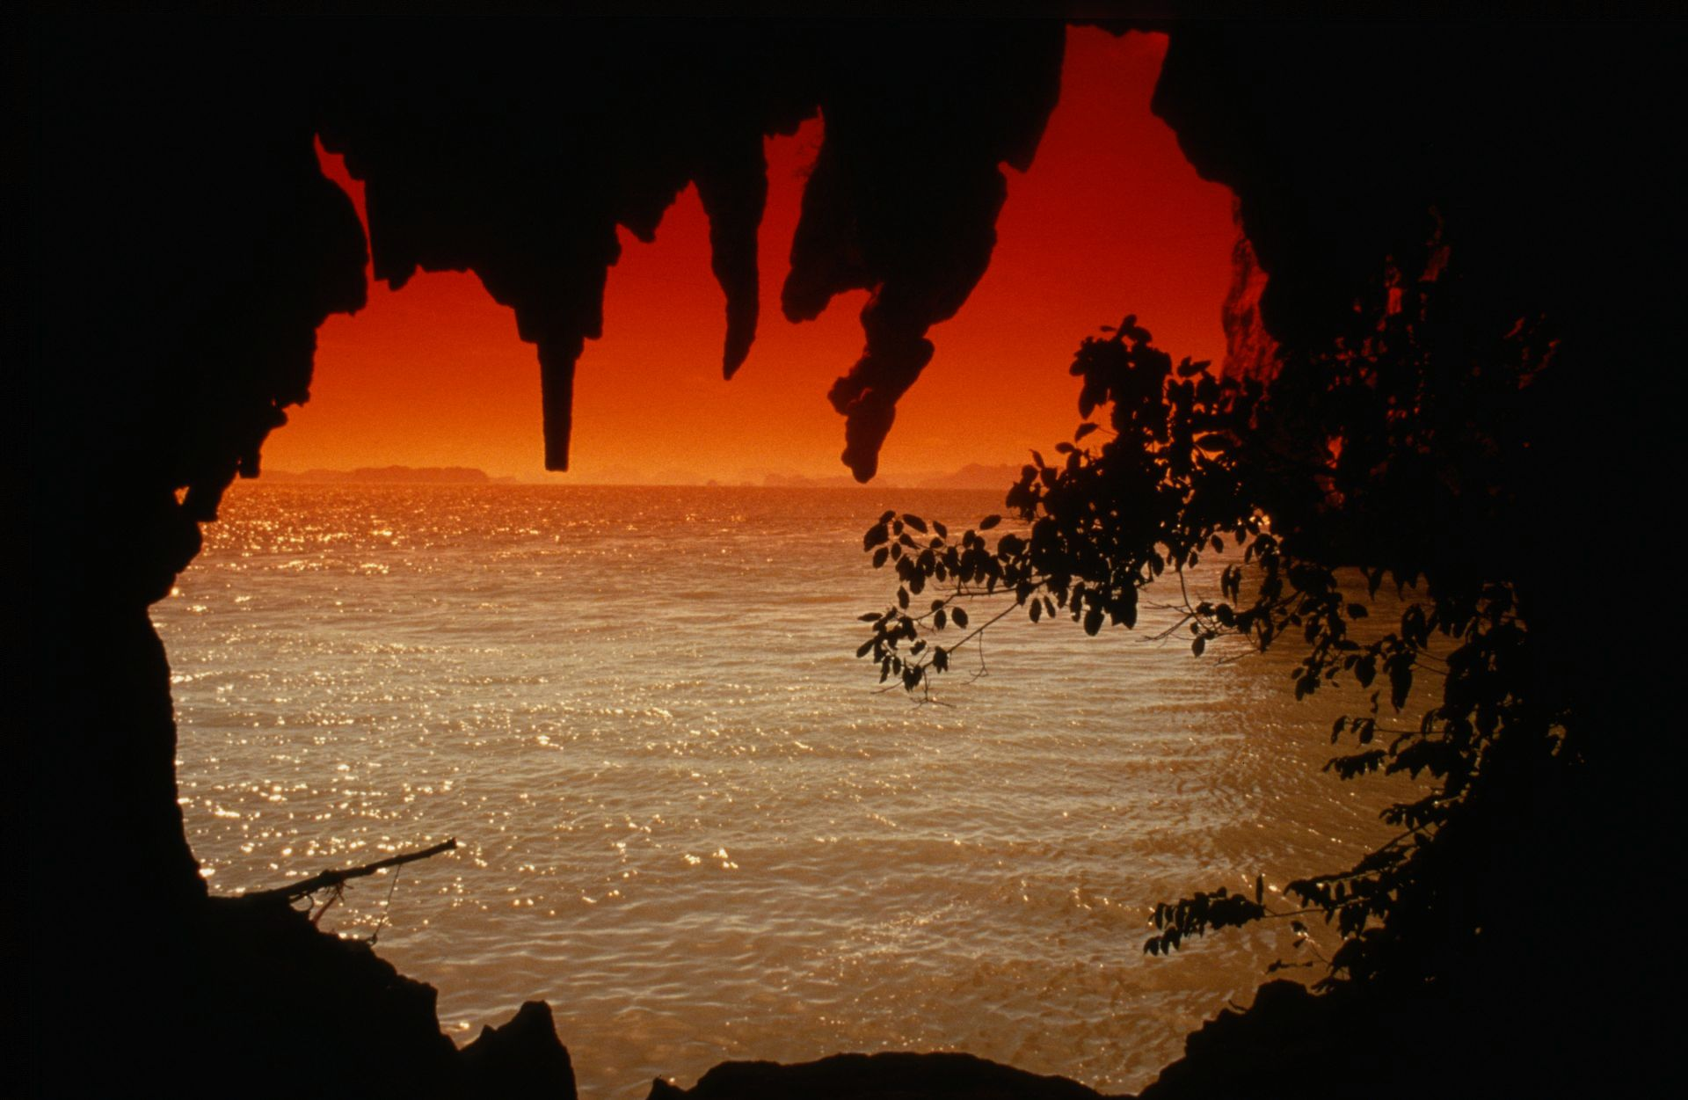
Notes:
Phang Nga Bay Cave, Thailand – Kevin Downey

Slide 3
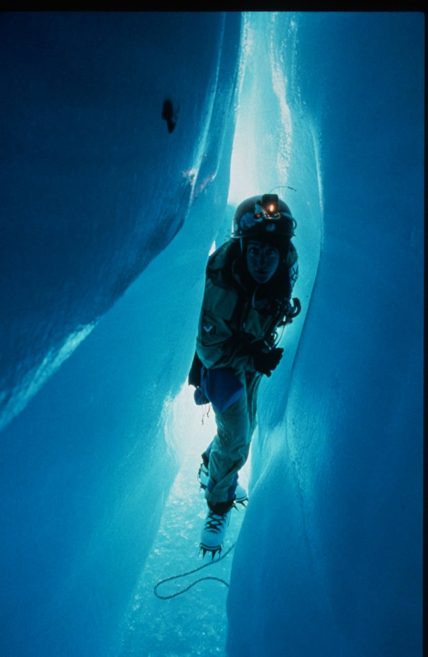
Notes:
The Sliding Squeeze – Marc Tremblay and Diana Gietl

Slide 4
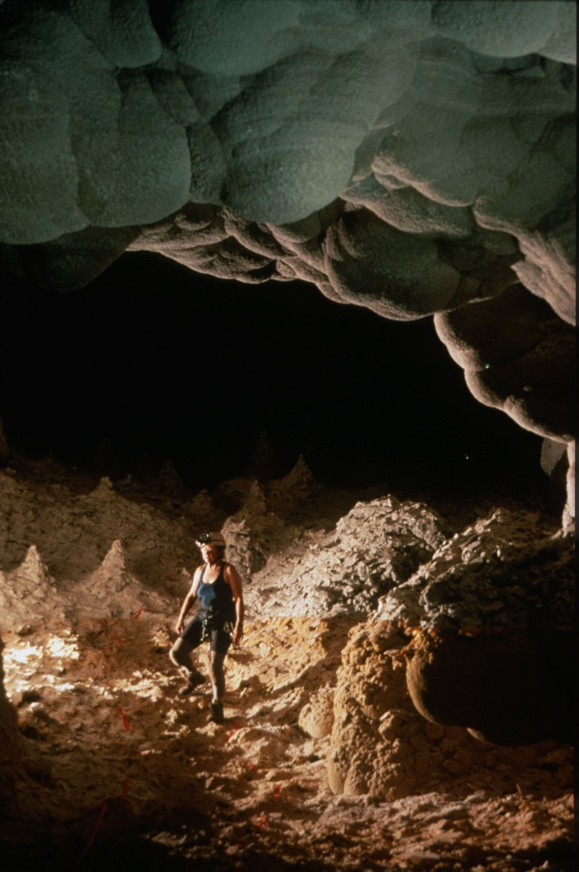
Notes:
The White Christmas Tree Room – Peter Jones

Slide 5
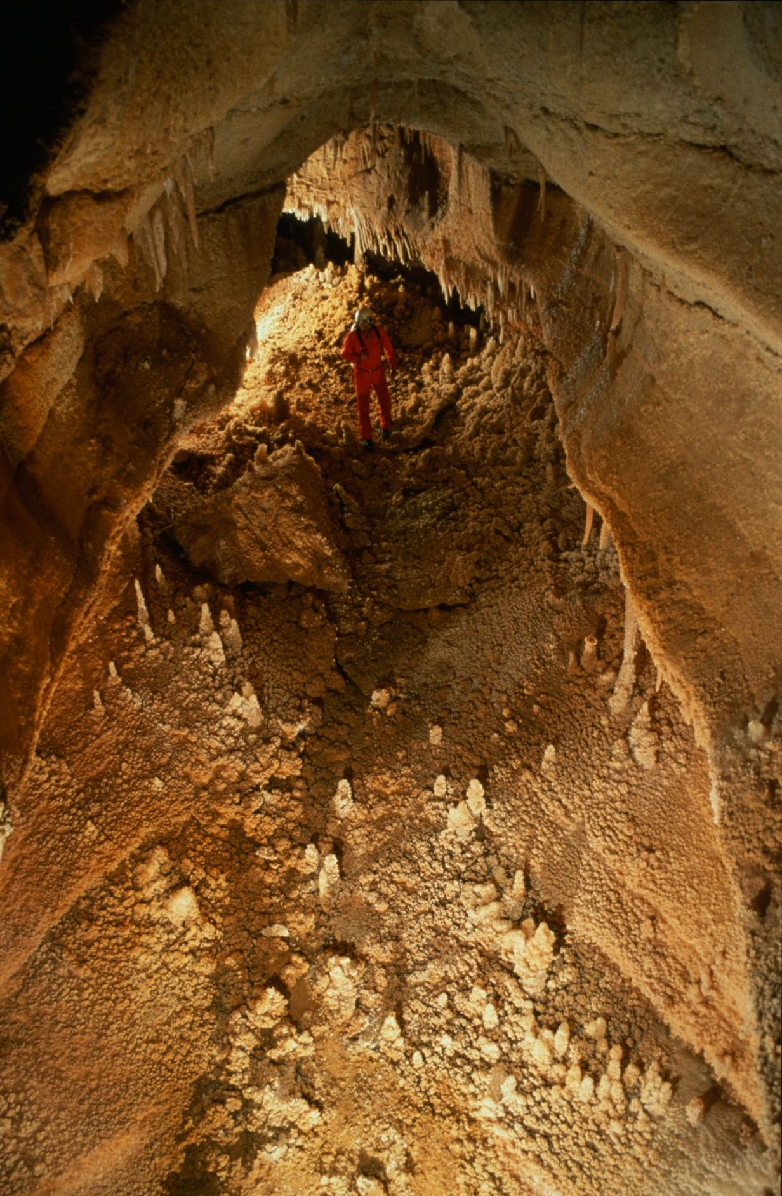
Notes:
Lower Levels, Caverns of Sonora – Kevin Downey and Urs Widmer

Slide 6
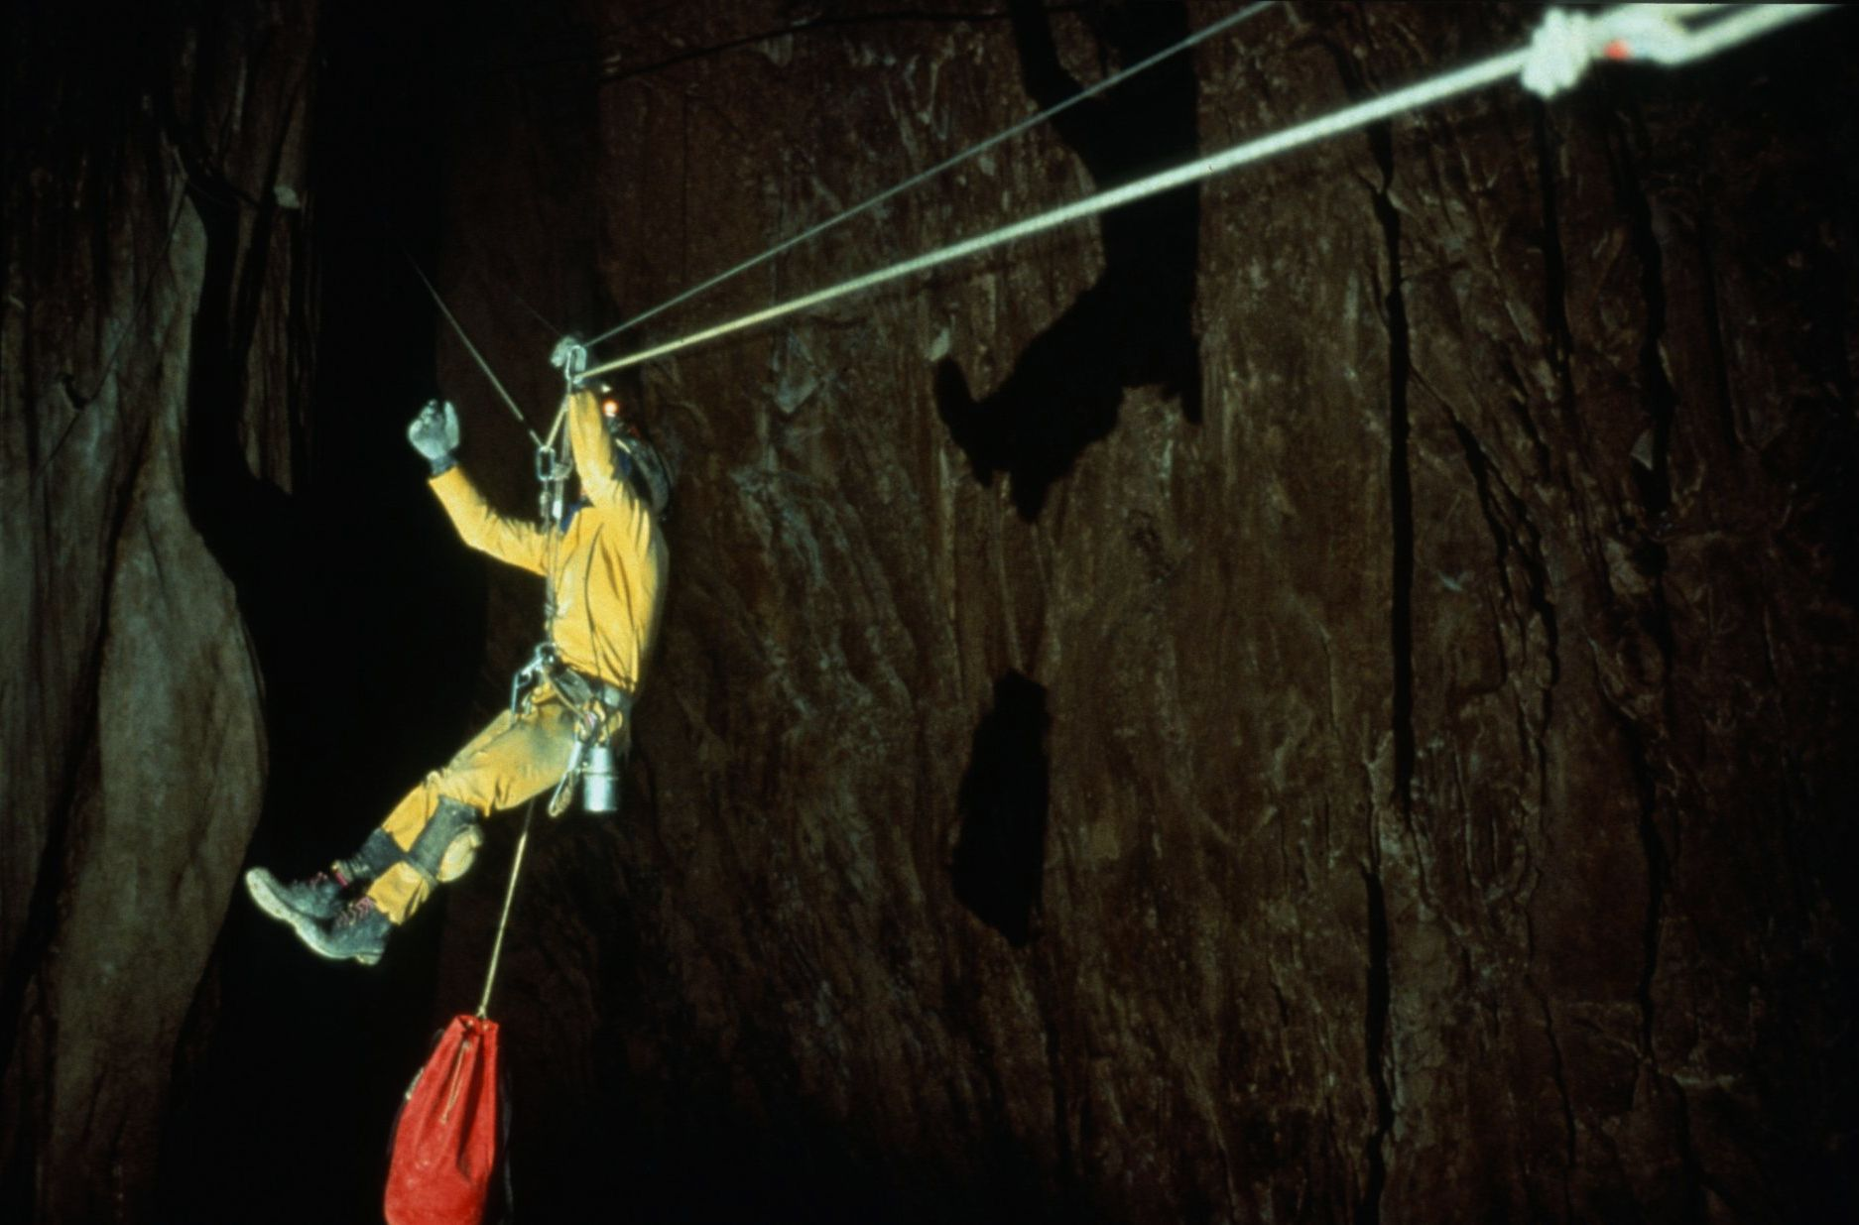
Notes:
Sta Elena System – Ramon Quintana

Slide 7
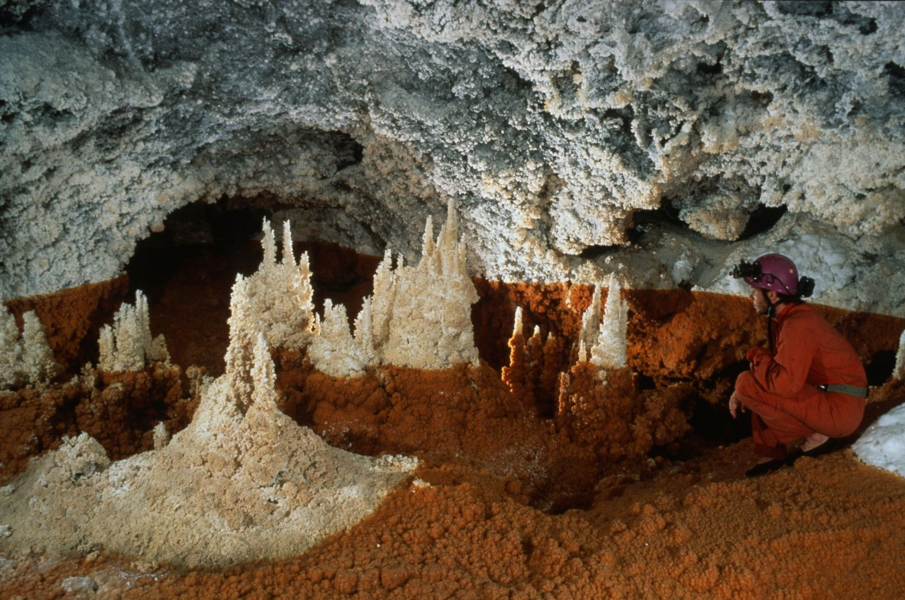
Notes:
White Islands in the Red Sea – Kevin Downey and Urs Widmer

Slide 8
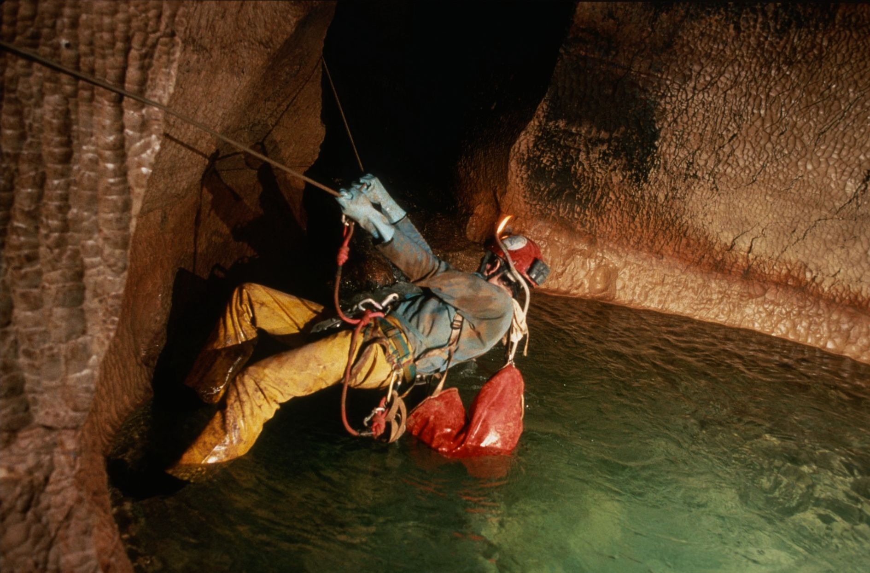
Notes:
Hanging Out – Peter Bosted

Slide 9
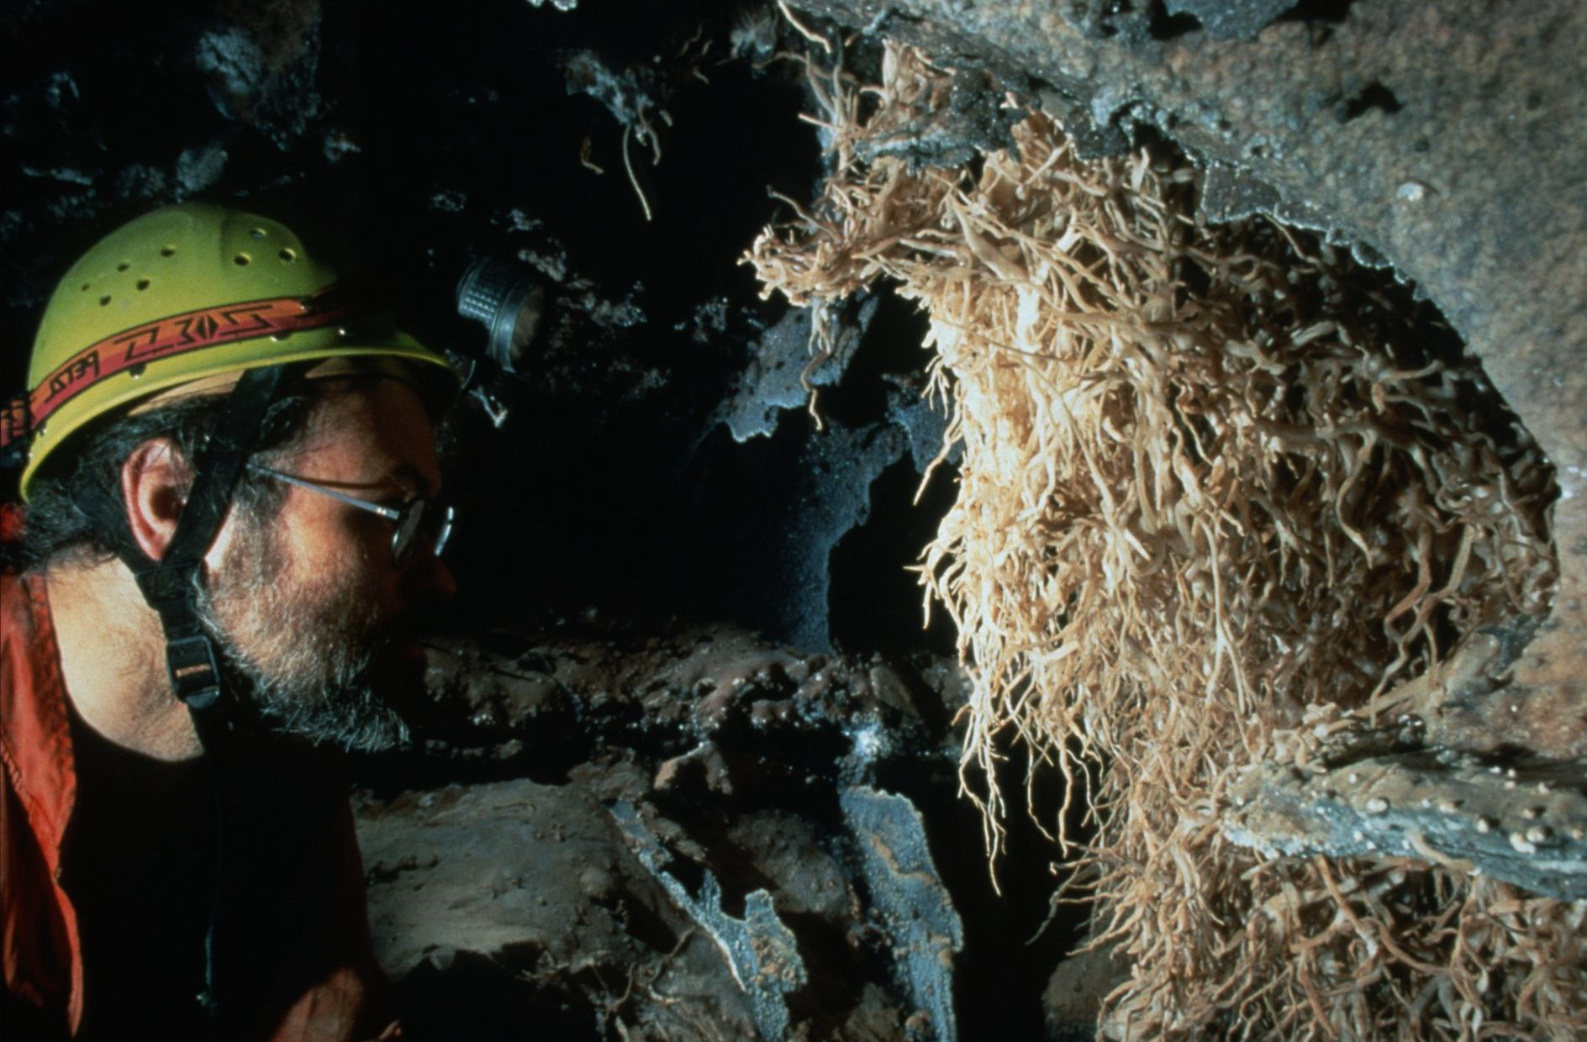
Notes:
Beard of the Emperor – Kevin Downey and Urs Widmer

Slide 10
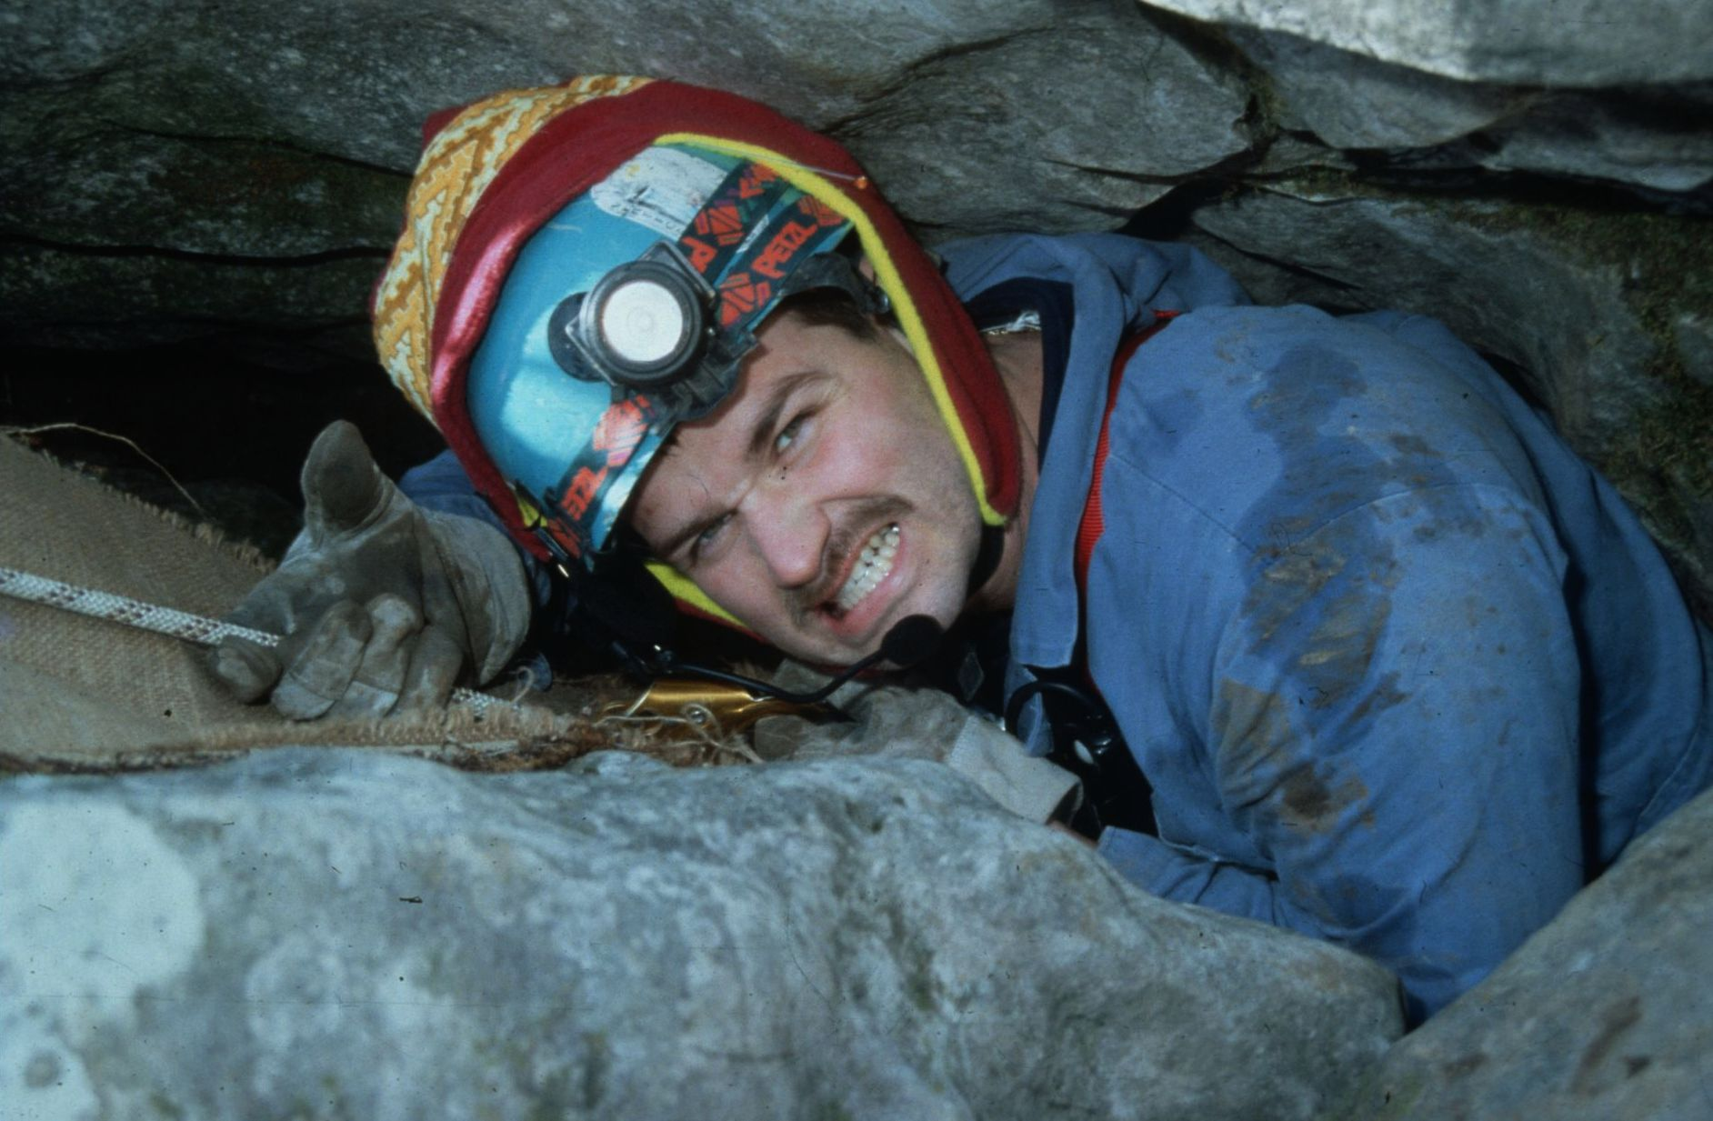
Notes:
Quick Someone Get Me the Slimfast – Colin Gatland

Slide 11
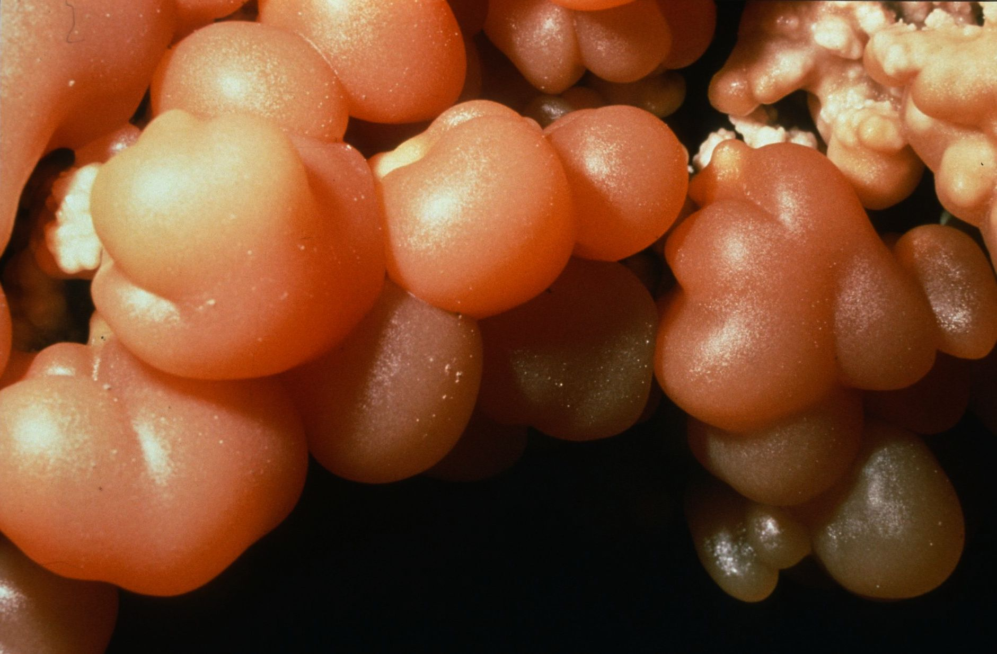
Notes:
Fruits of the Underworld – Kevin Downey and Urs Widmer

Slide 12
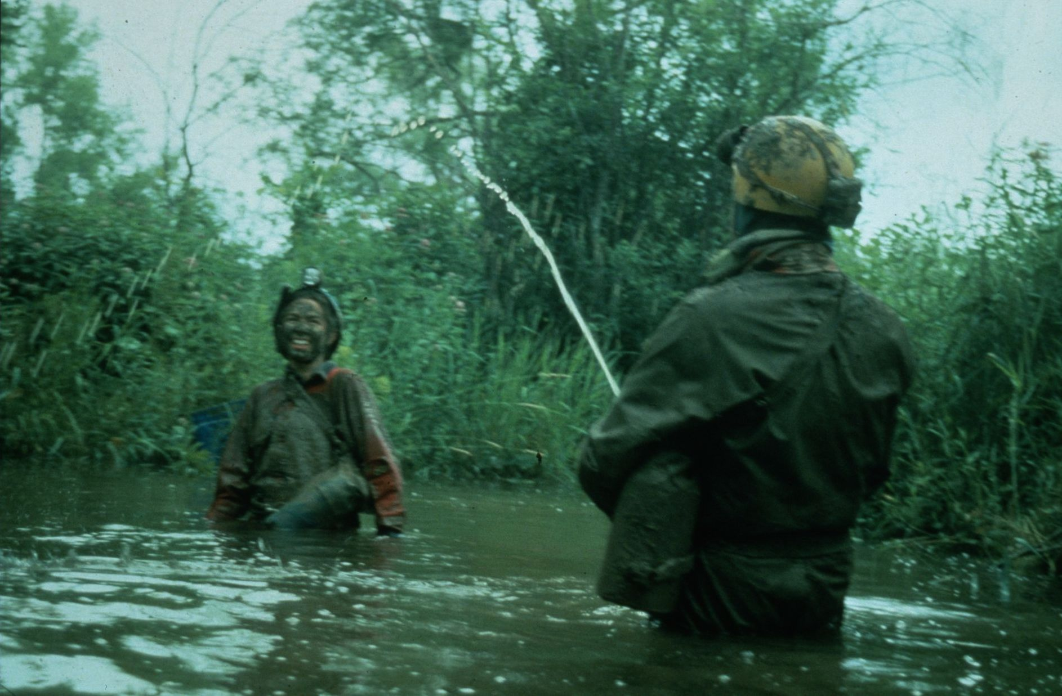
Notes:
Rinsing Off – Ken Davis

Slide 13
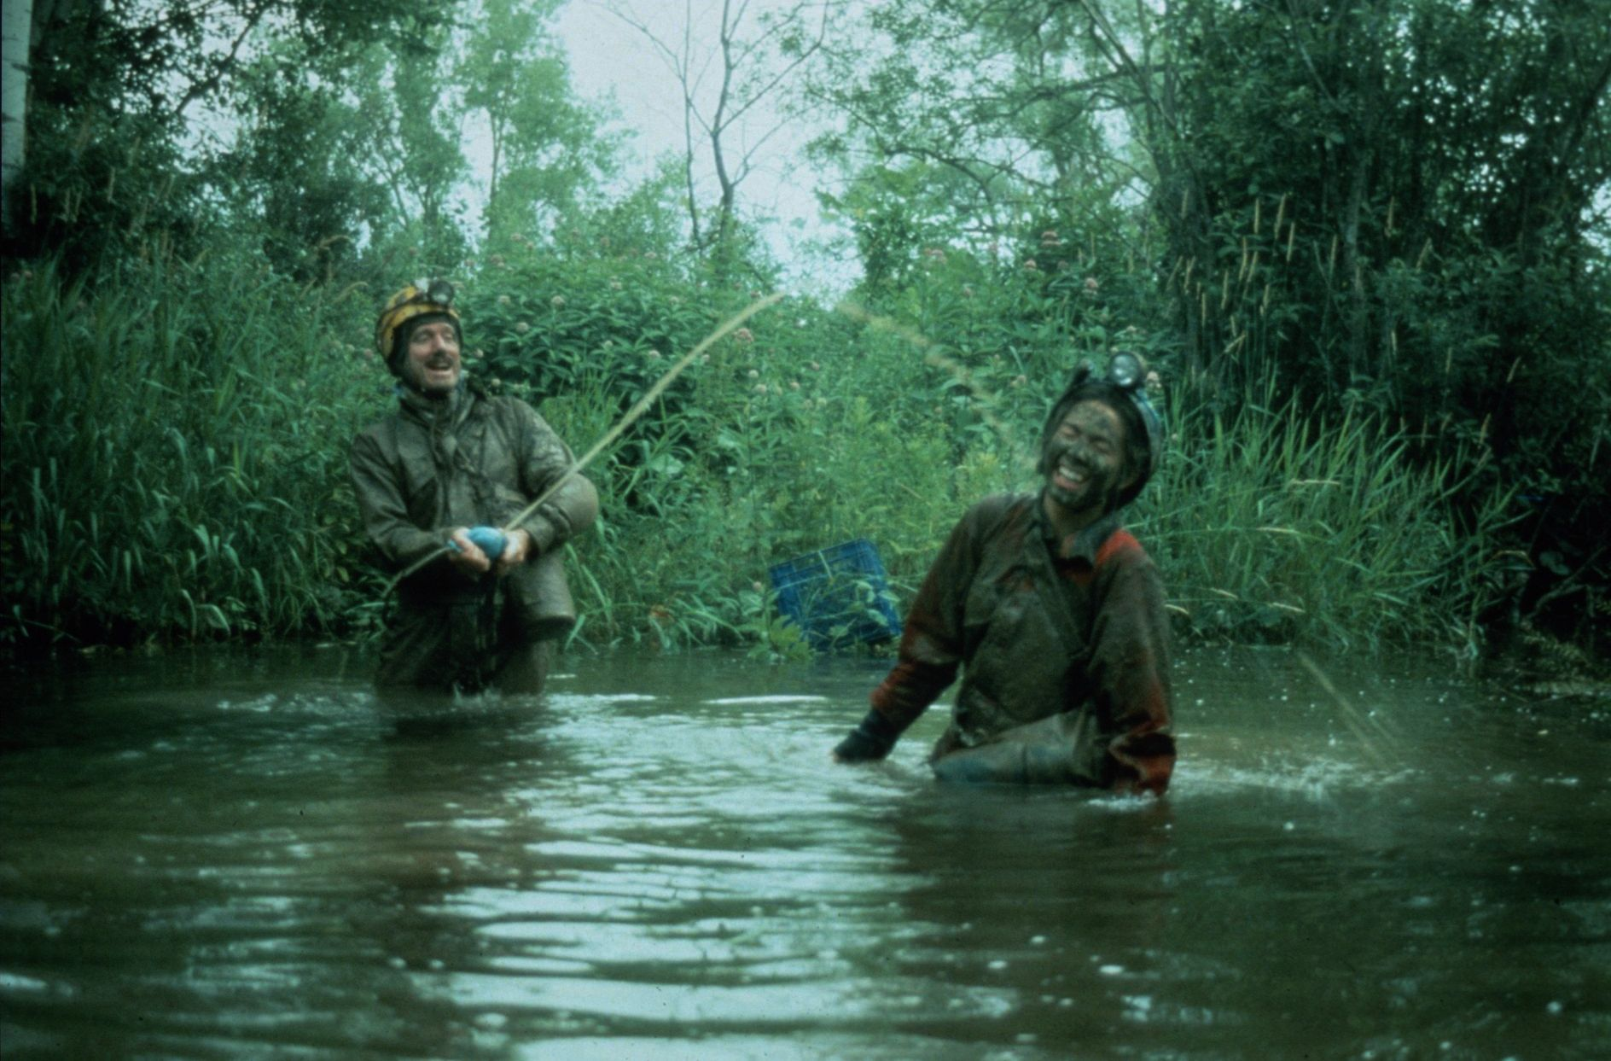
Notes:
Rinsing Off – Ken Davis

Slide 14
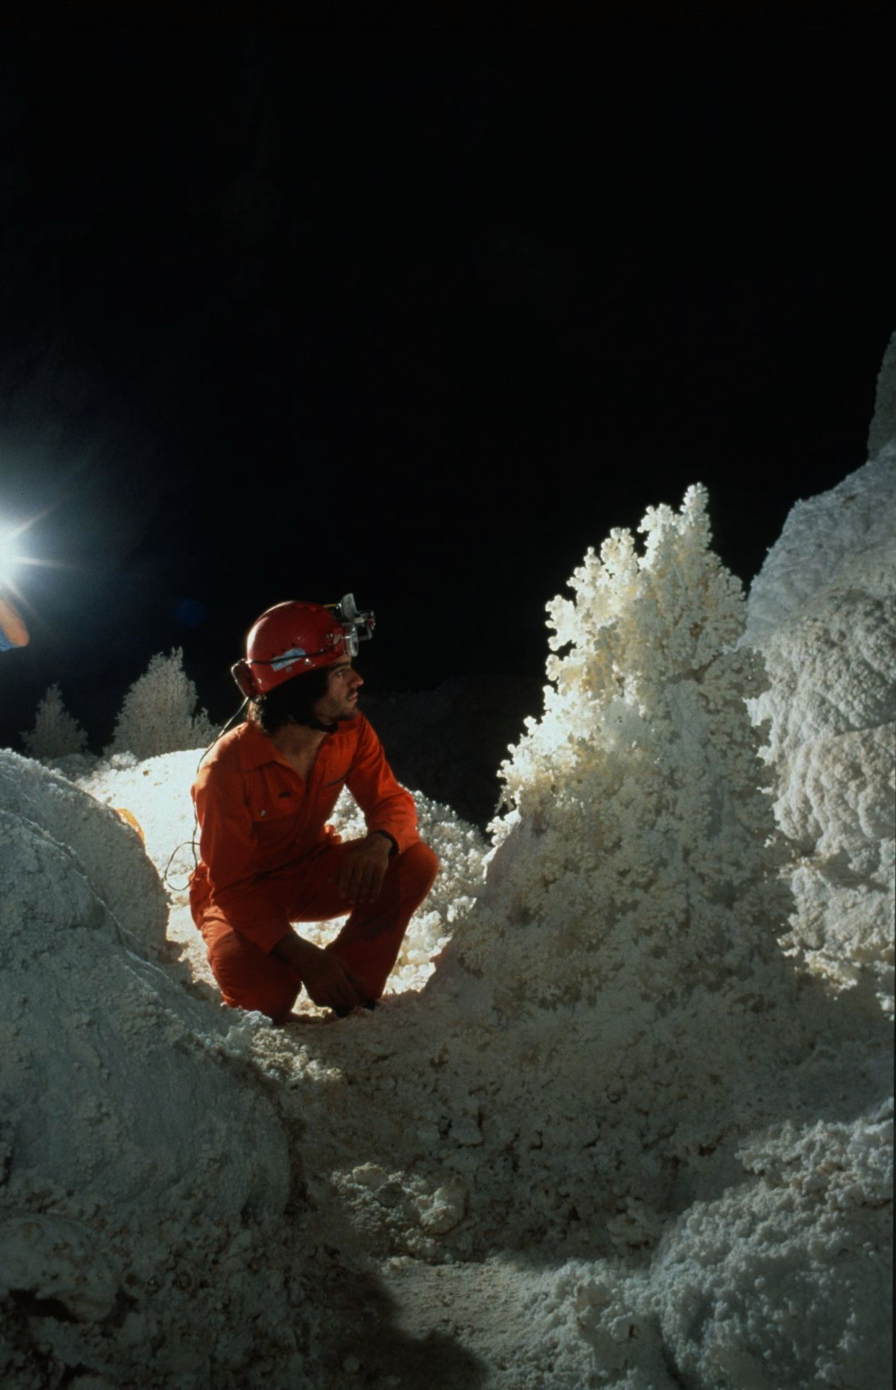
Notes:
Aragonite Wonder – Kevin Downey

Slide 15
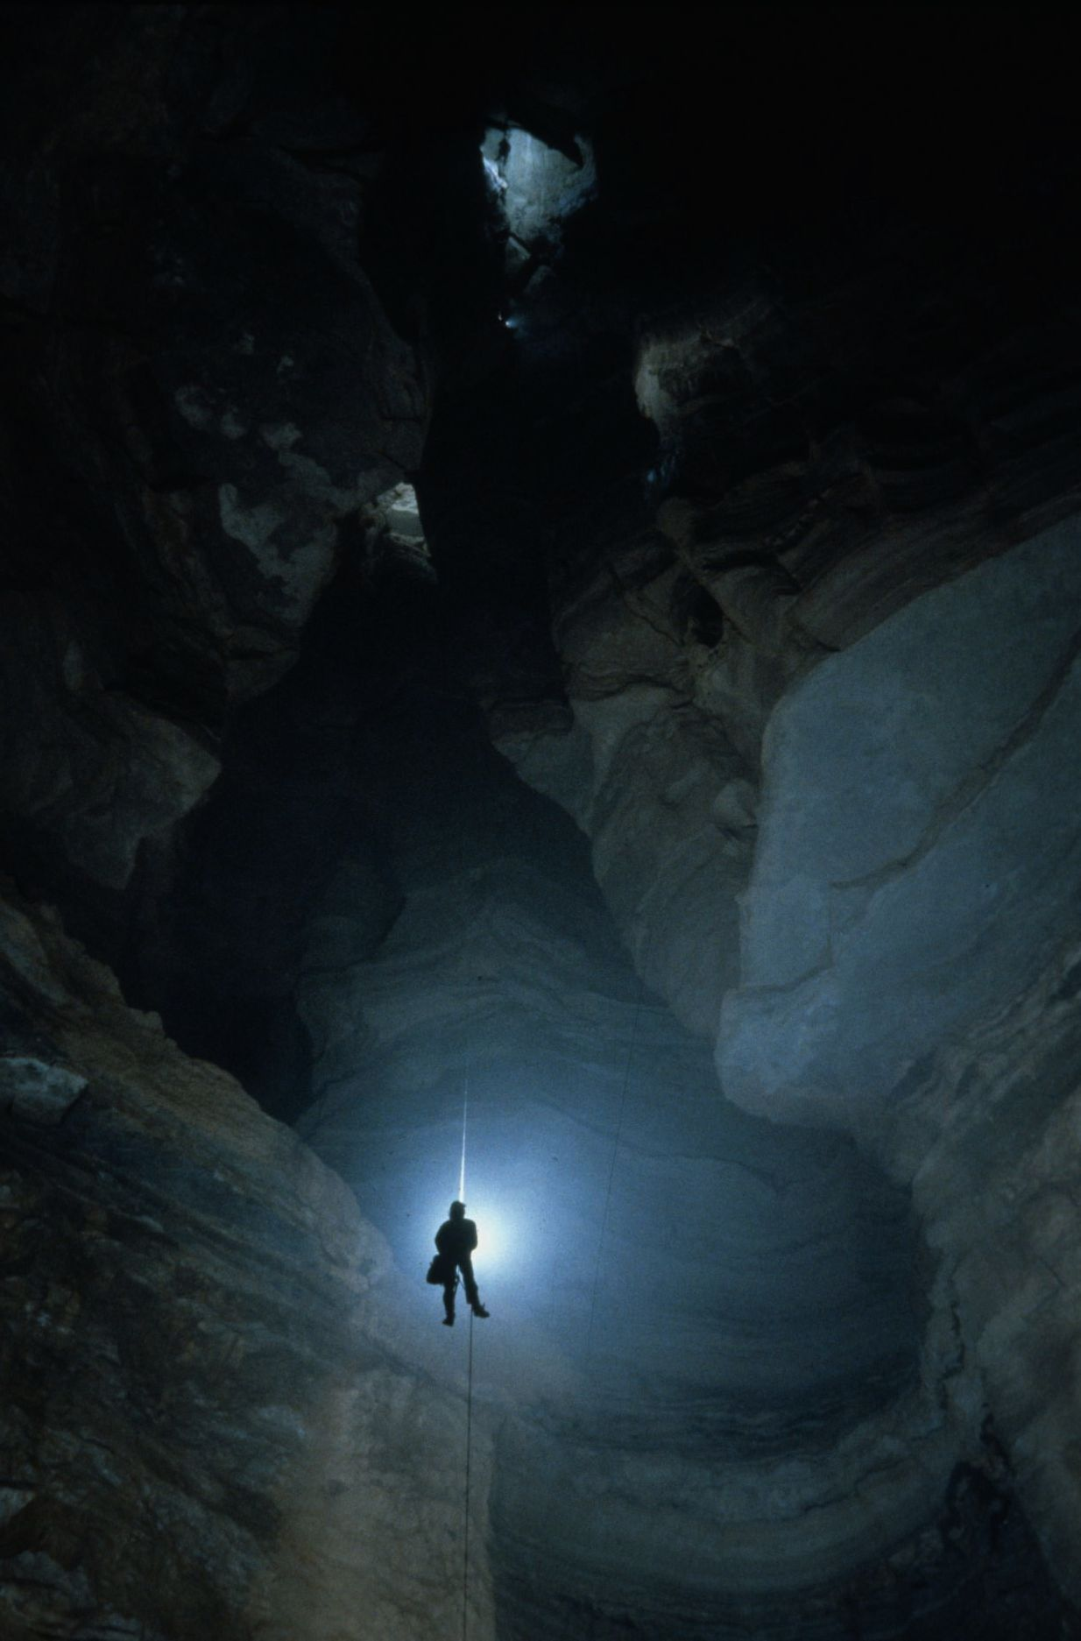
Notes:
Solitary Ascent in the Great Abyss, Part Two – Gary Phelps

Slide 16
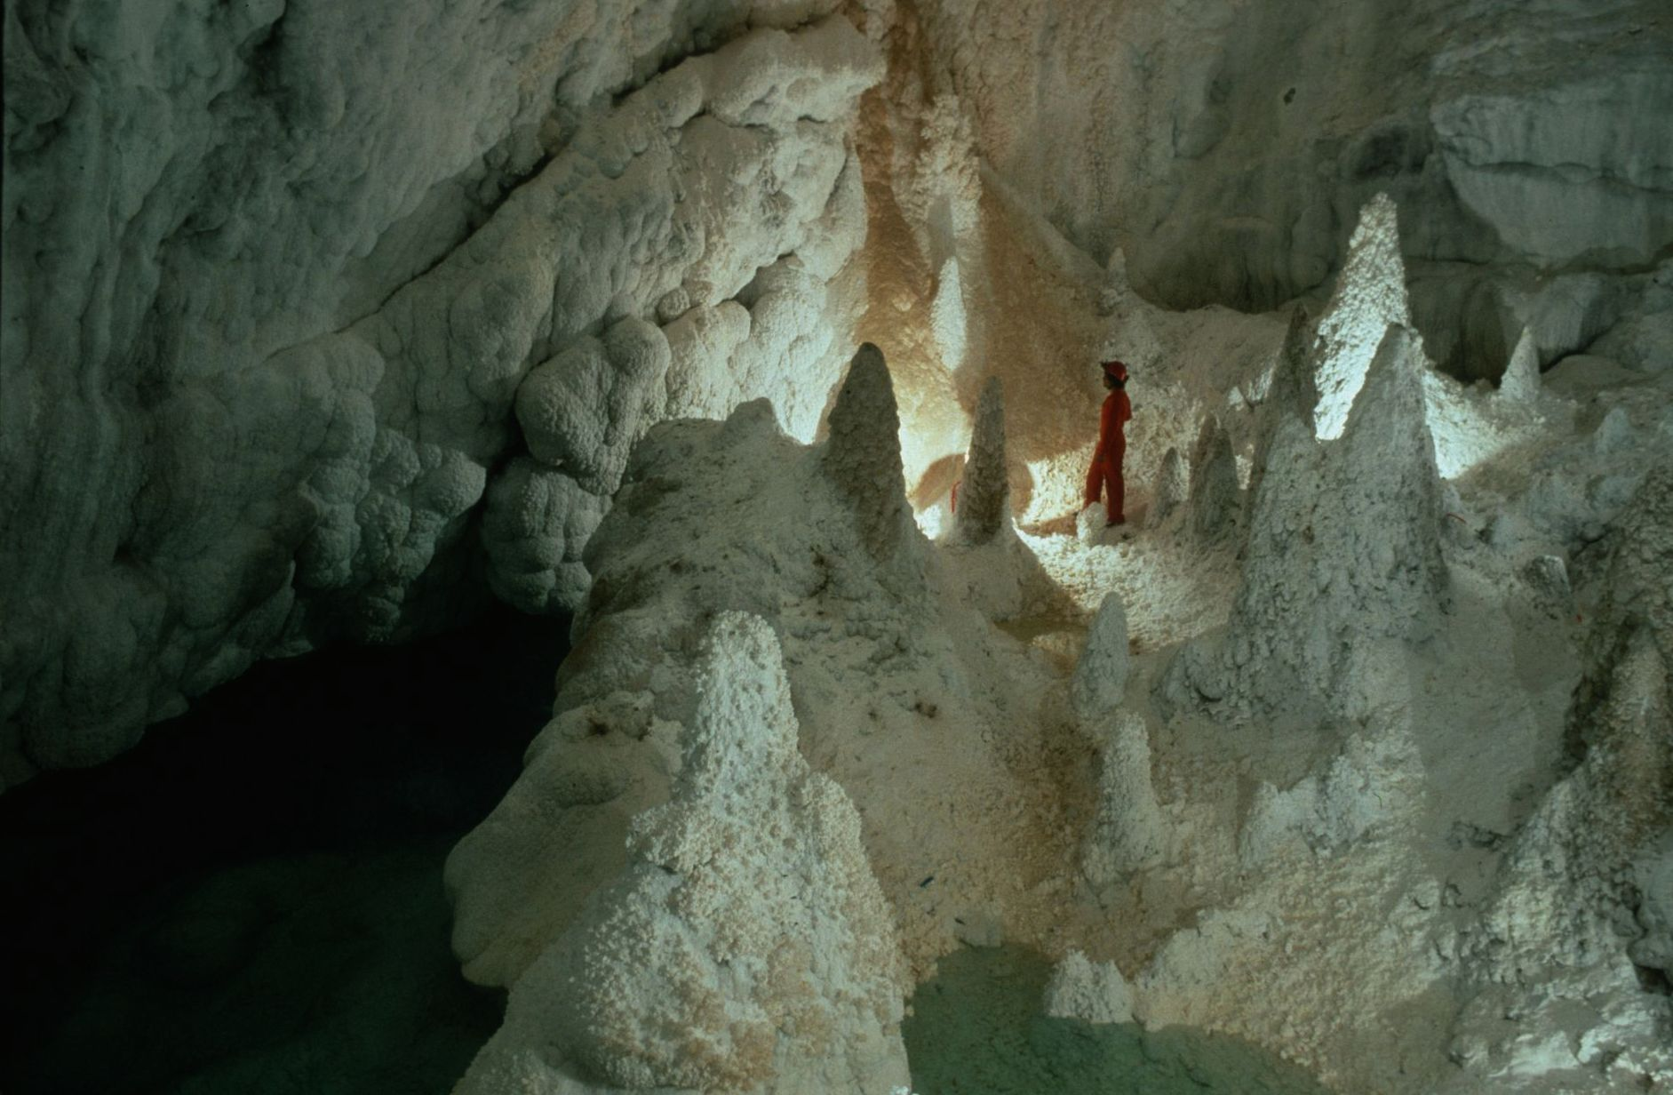
Notes:
A Paradise of Hoodoos – Kevin Downey and Urs Widmer

Slide 17
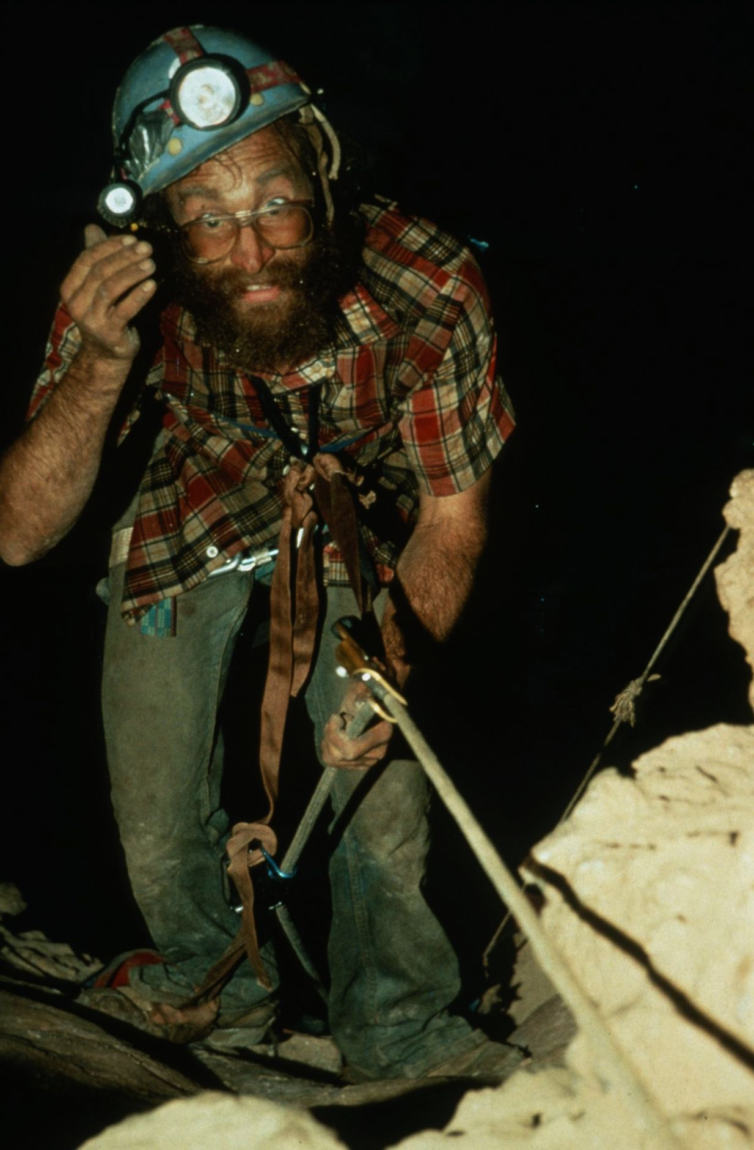
Notes:
After the Climb – Peter Jones

Slide 18
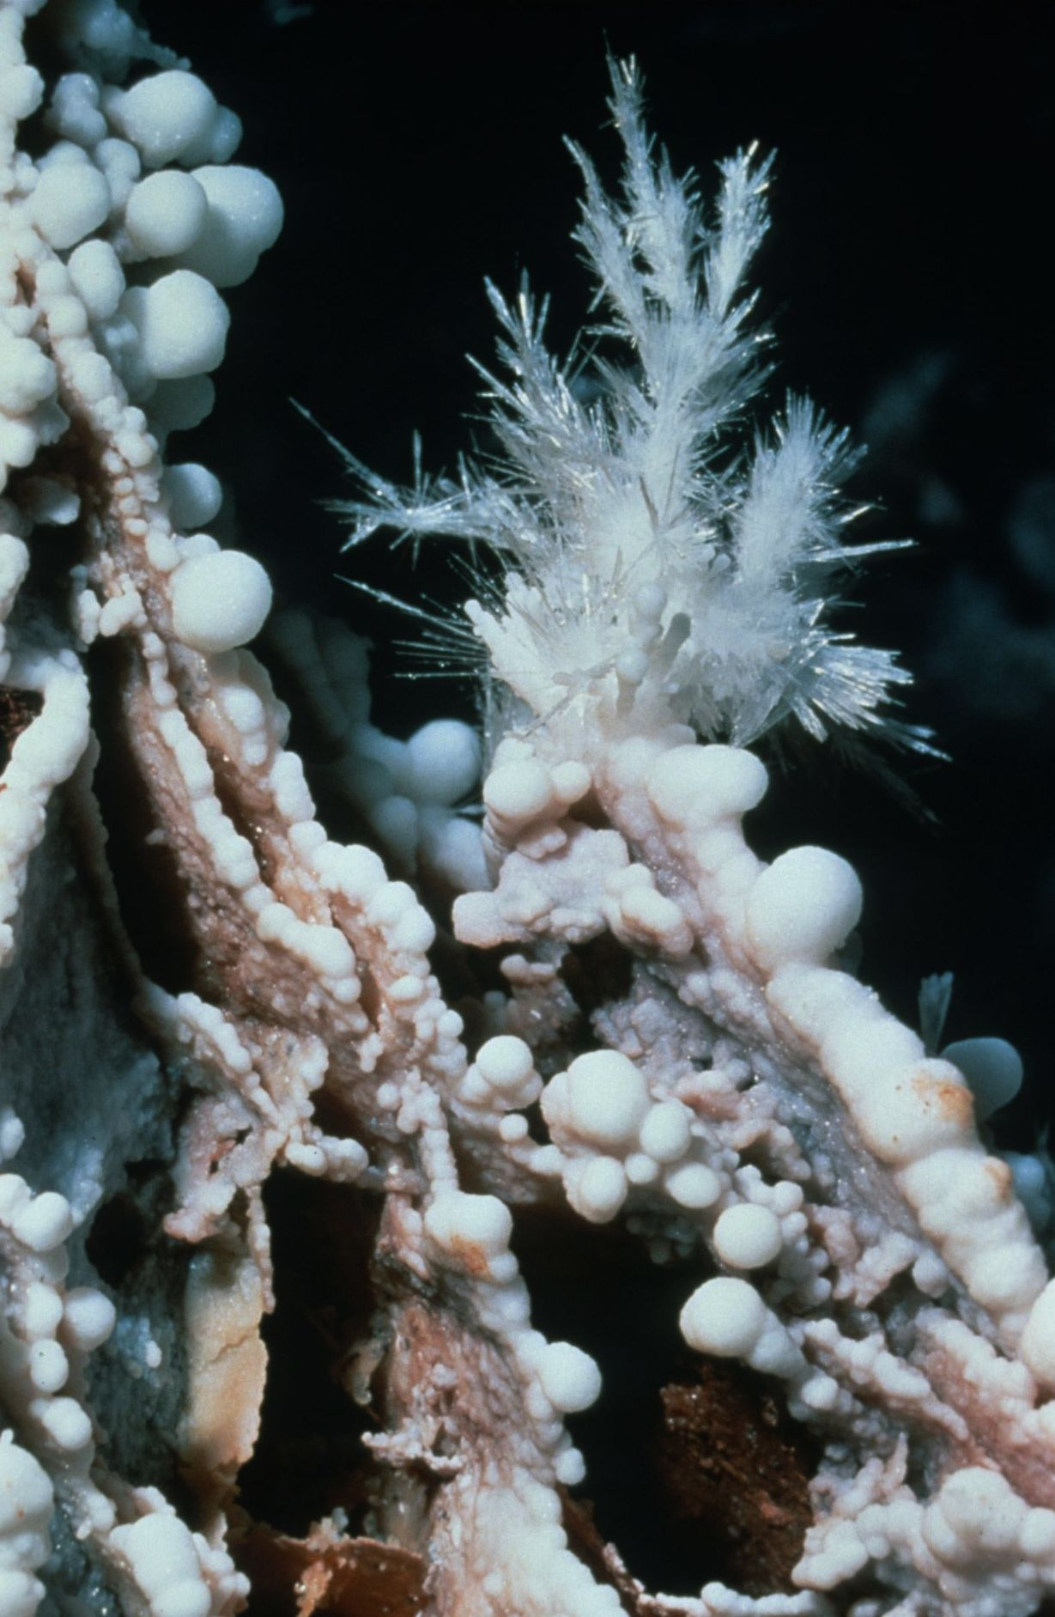
Notes:
Aragonite on Popcorn – Kevin Downey and Urs Widmer

Slide 19
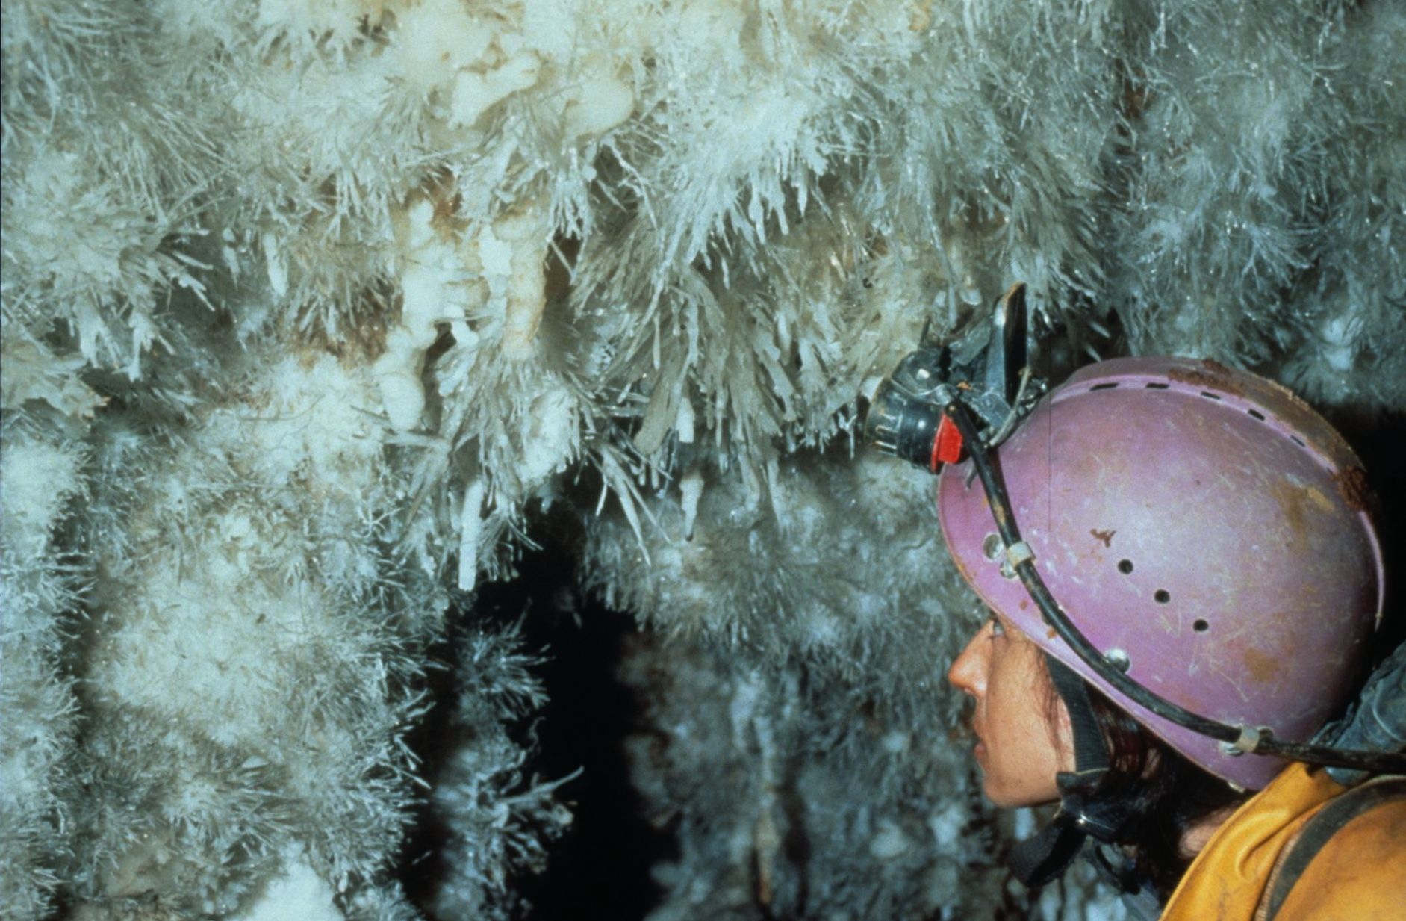
Notes:
Incredible Wall – Ramon Quintan

Slide 20
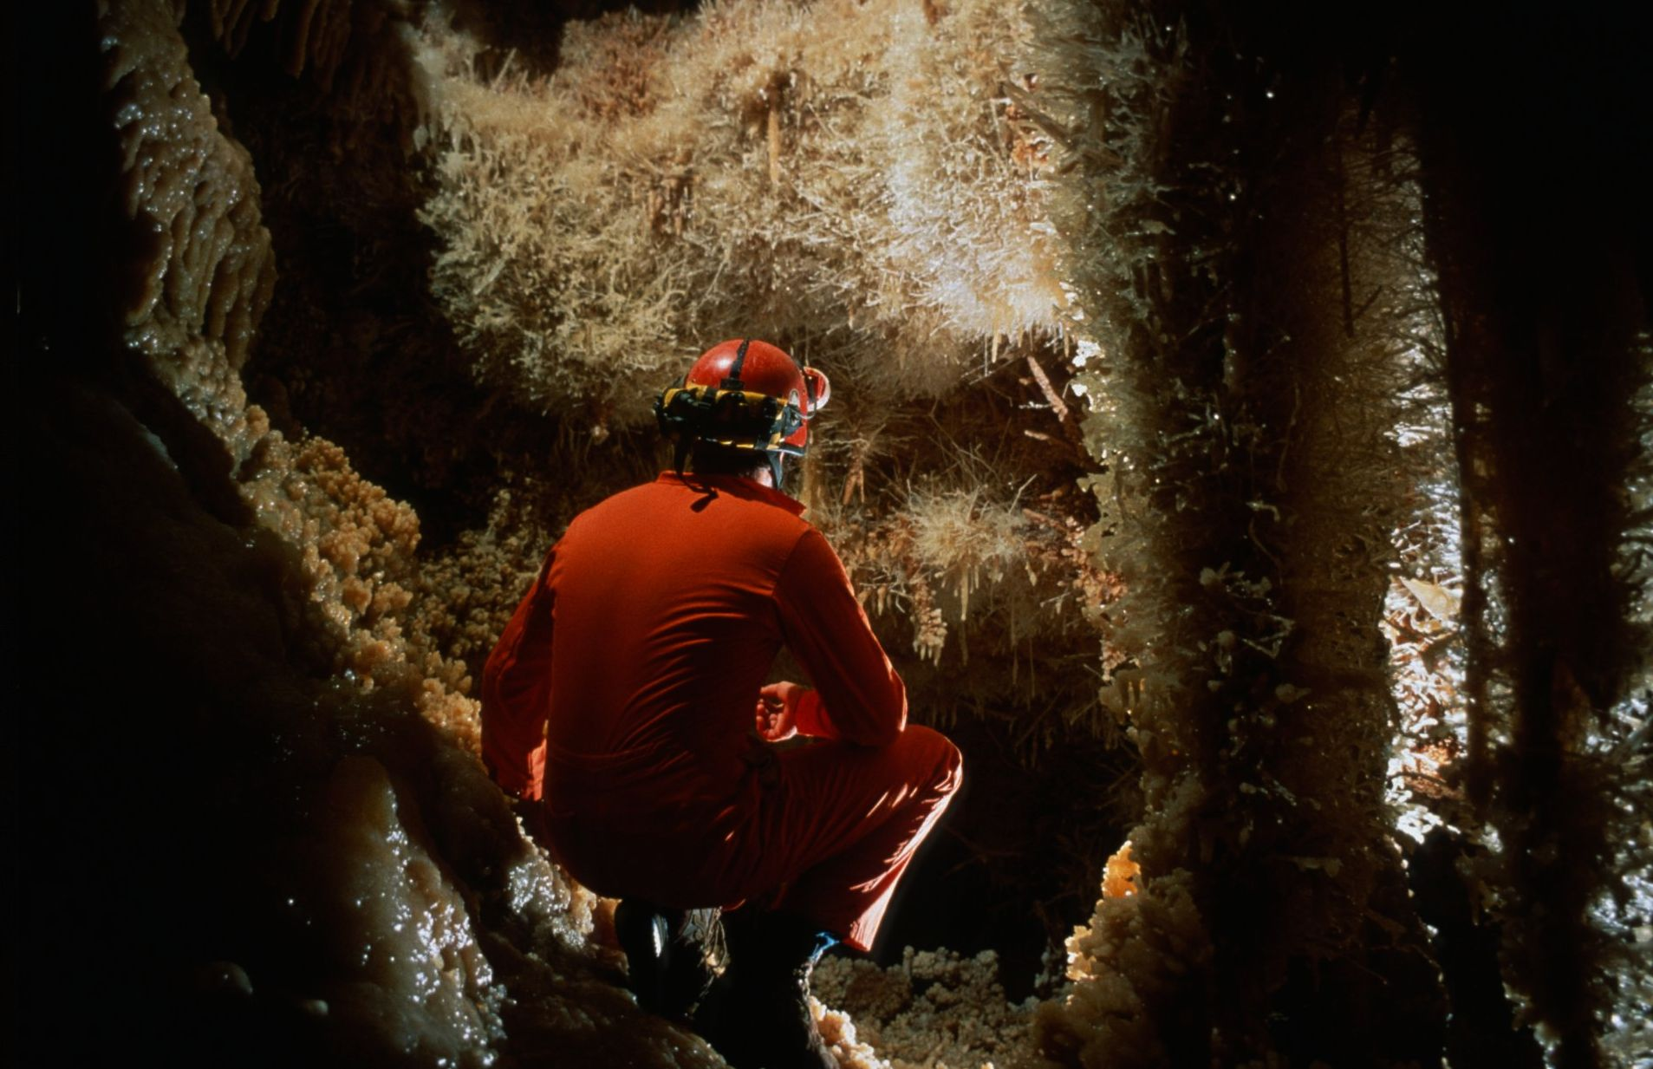
Notes:
Helictite Madness -- Kevin Downey and Urs Widmer

Slide 21
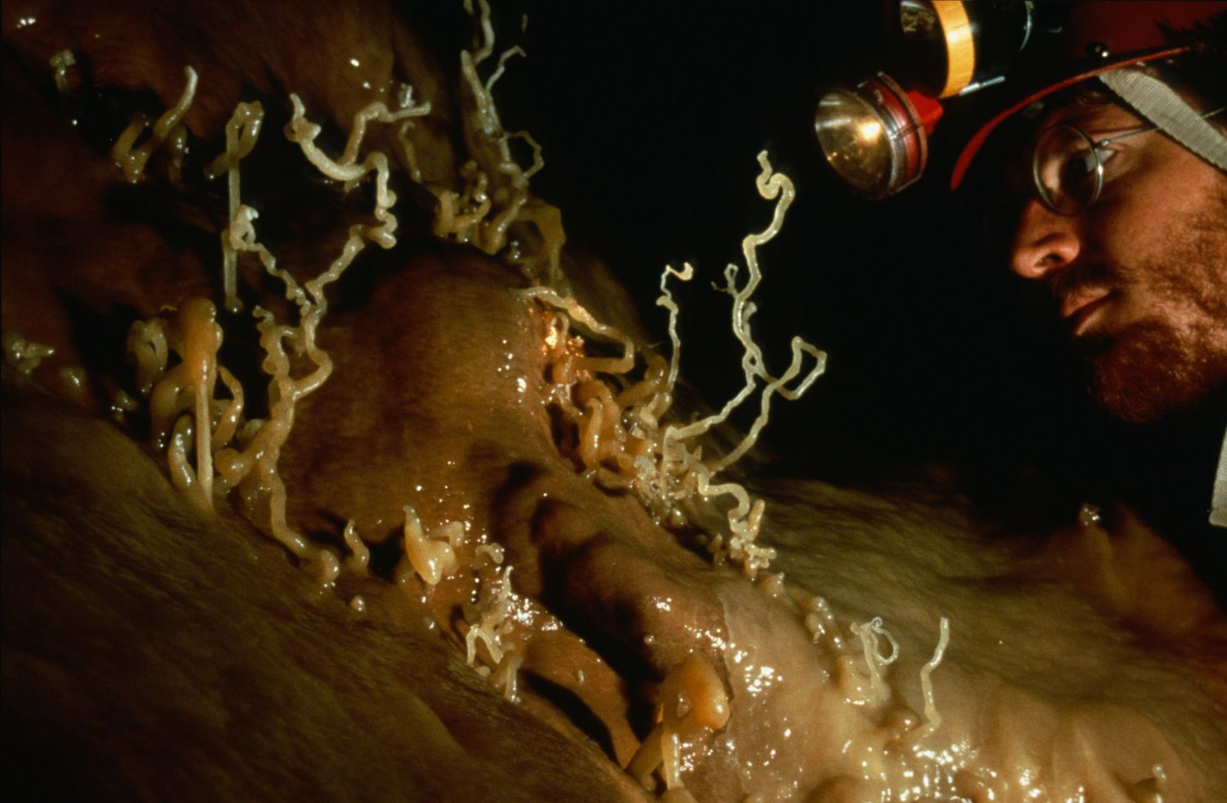
Notes:
Hell Below Helictites – Ken Davis

Slide 22
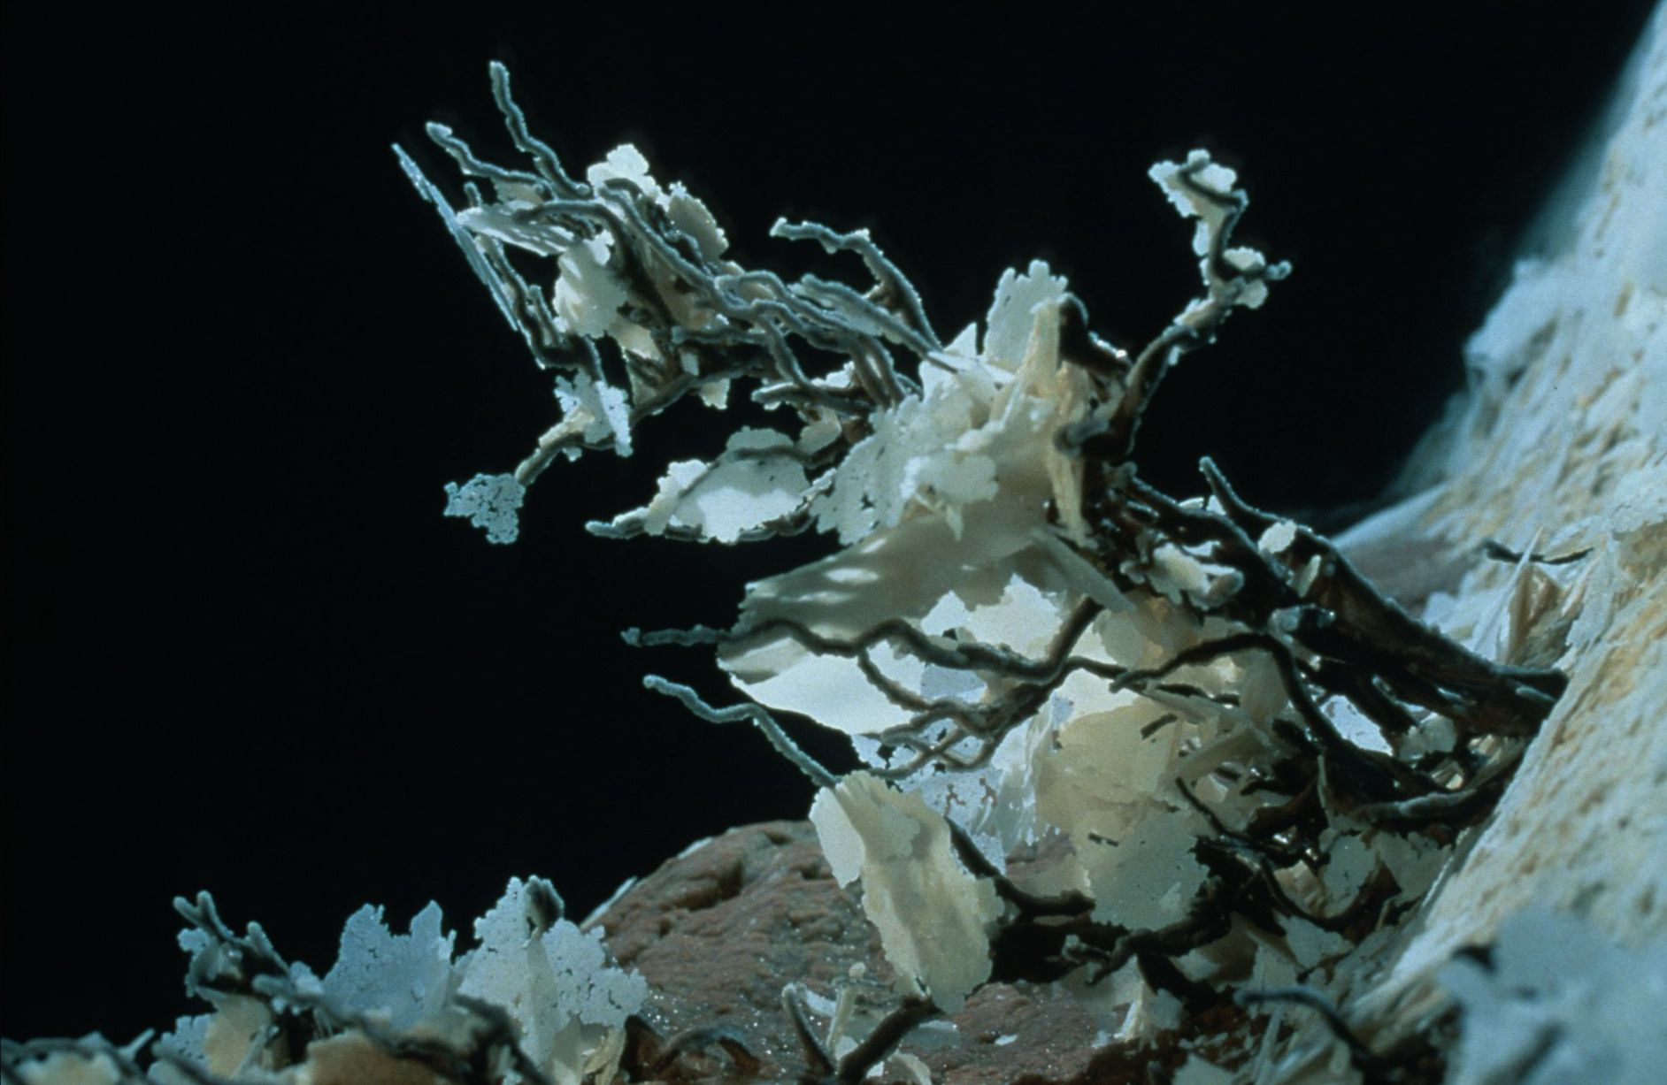
Notes:
Helictite Bush With Rafts - Kevin Downey and Urs Widmer

Slide 23
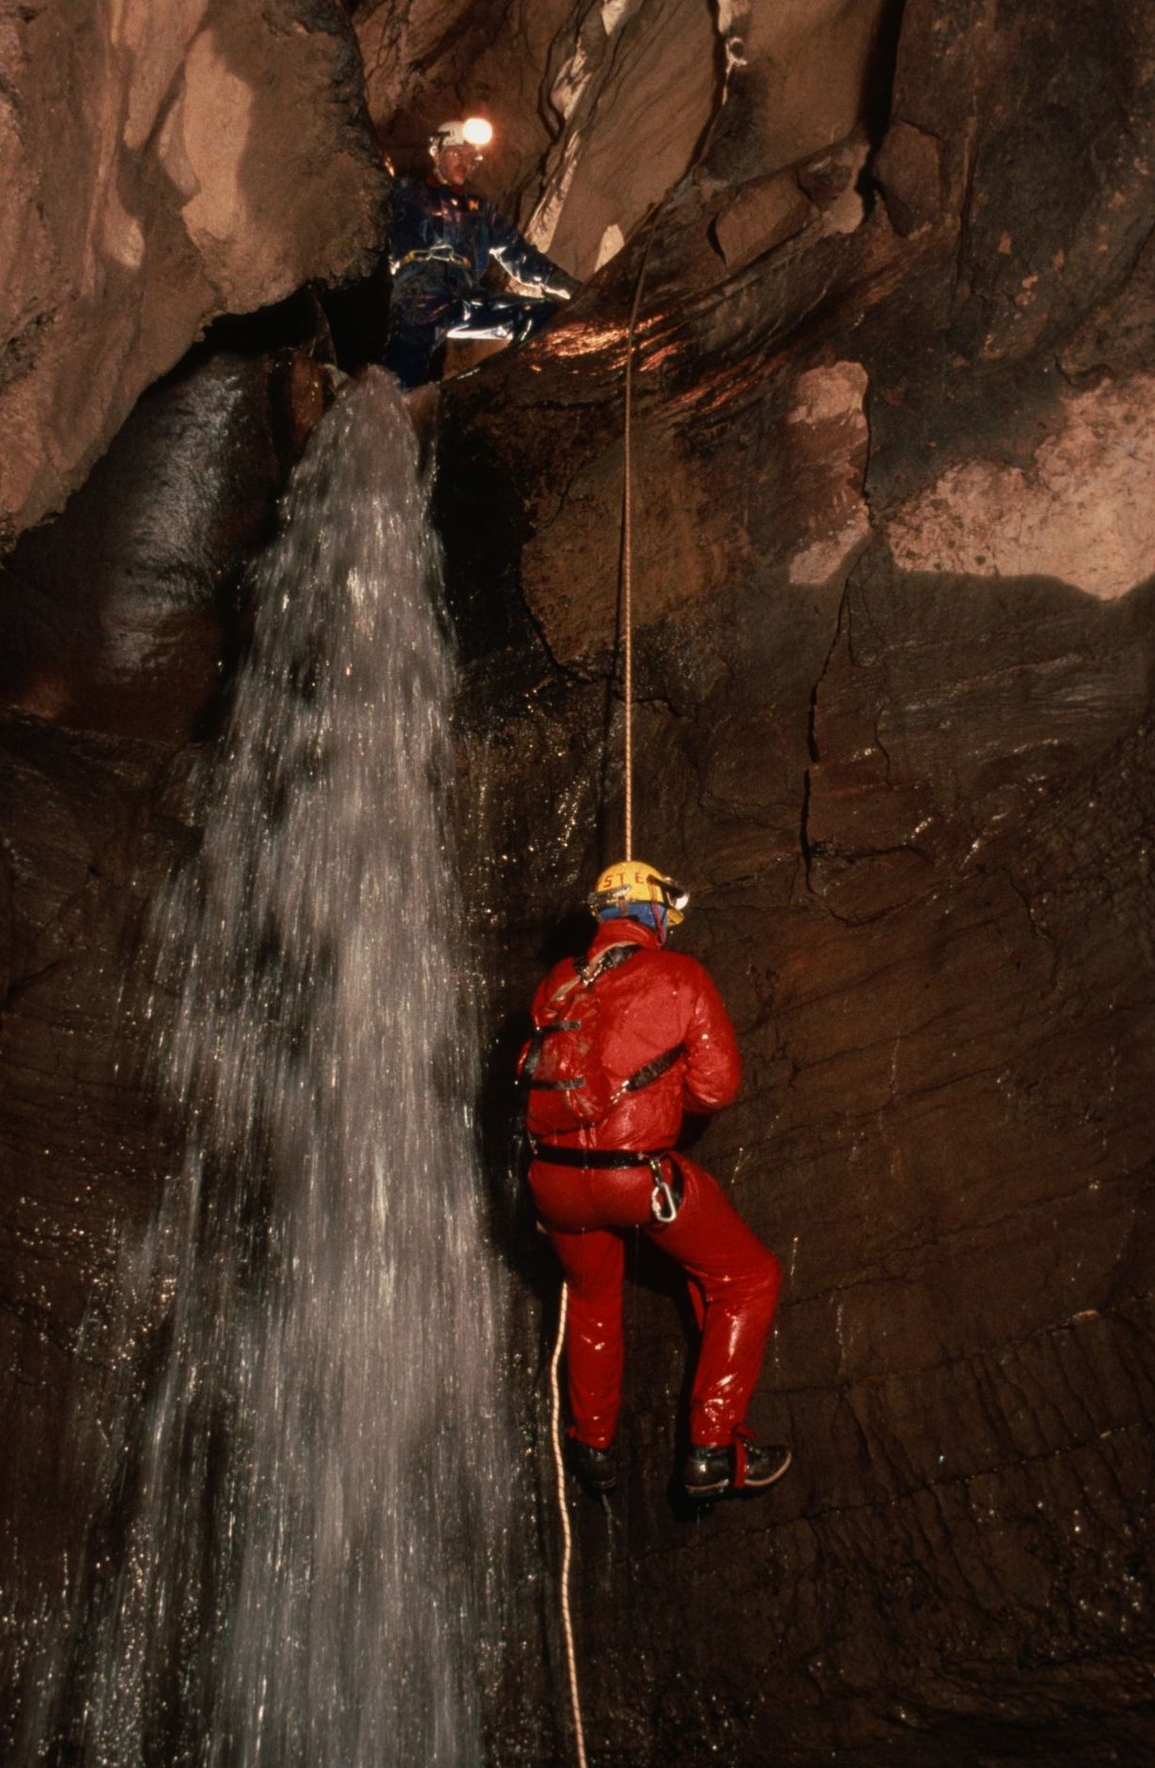
Notes:
Soap on a Rope – Ed McCarthy and Carl Samples

Slide 24
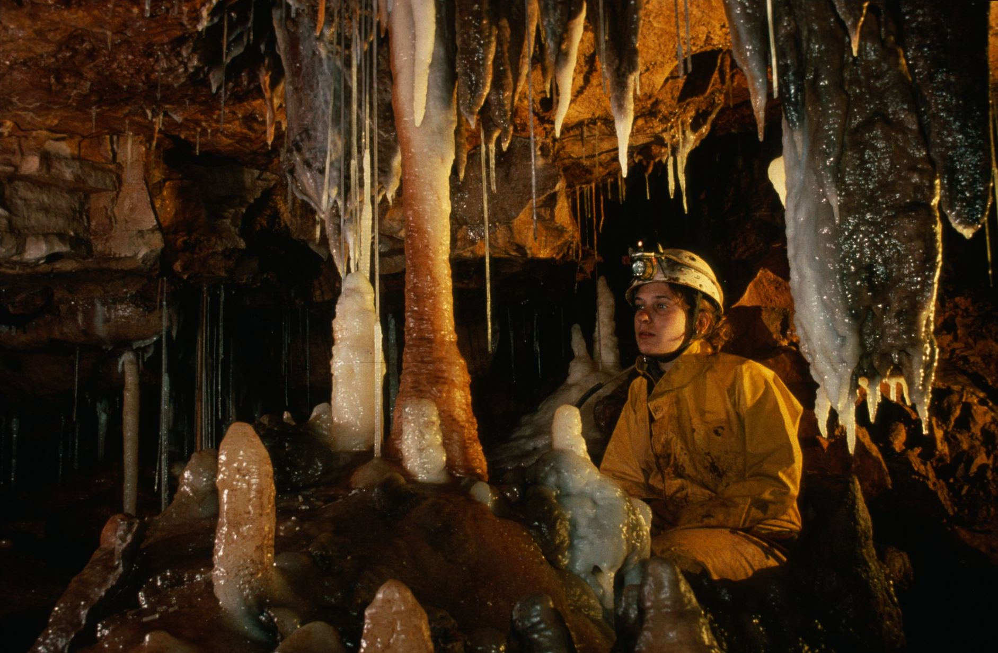
Notes:
A Bright Hue – Peter and Ann Bosted

Slide 25
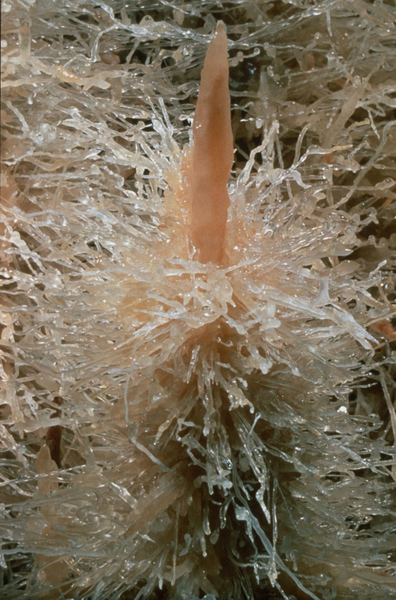
Notes:
Crystal Hedge Hog - Kevin Downey and Urs Widmer

Slide 26
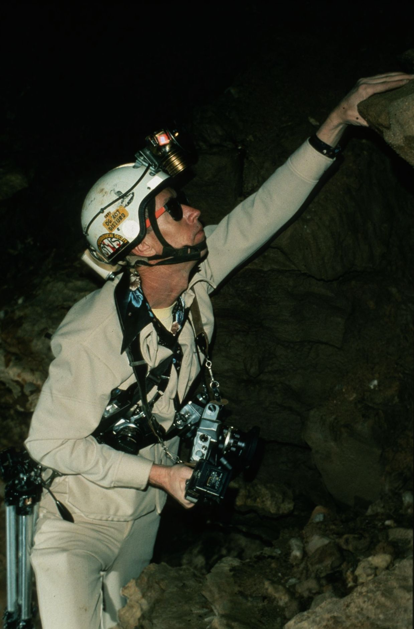
Notes:
Alphonse DuPuy – Famous Cave Photographer – Richard Vernier

Slide 27
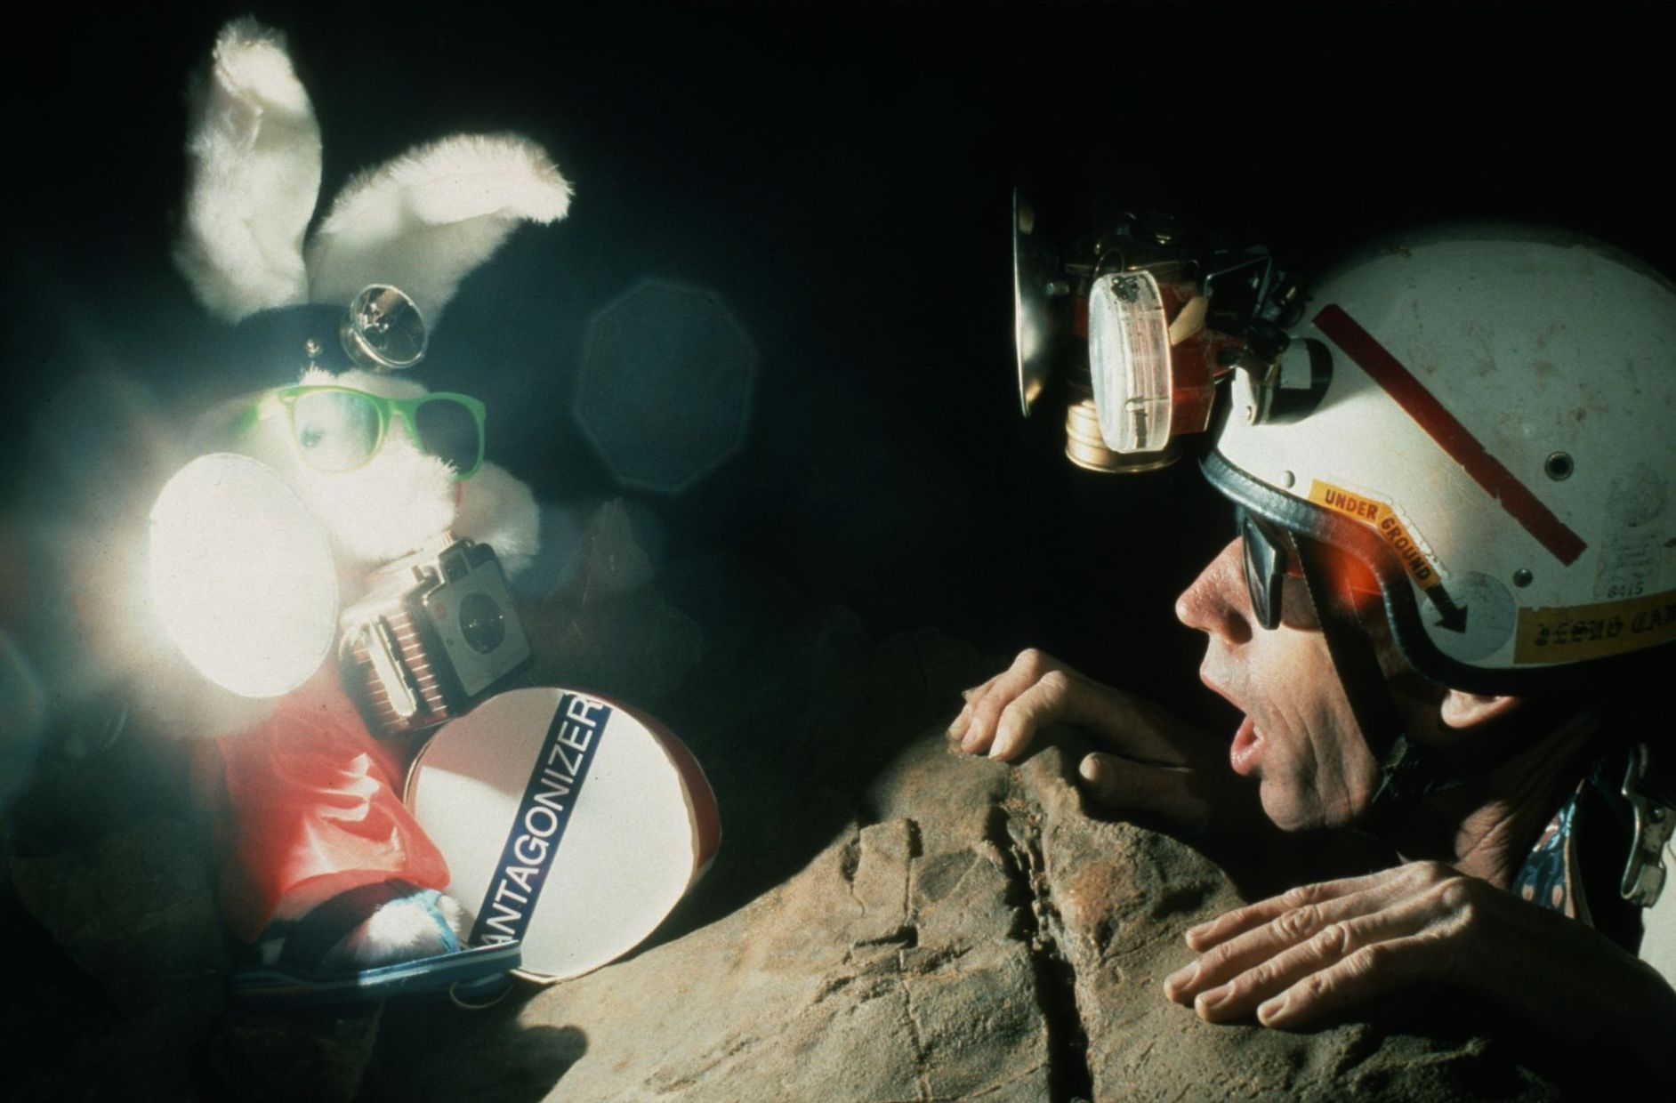
Notes:
…Still Going… - Richard Vernier

Slide 28
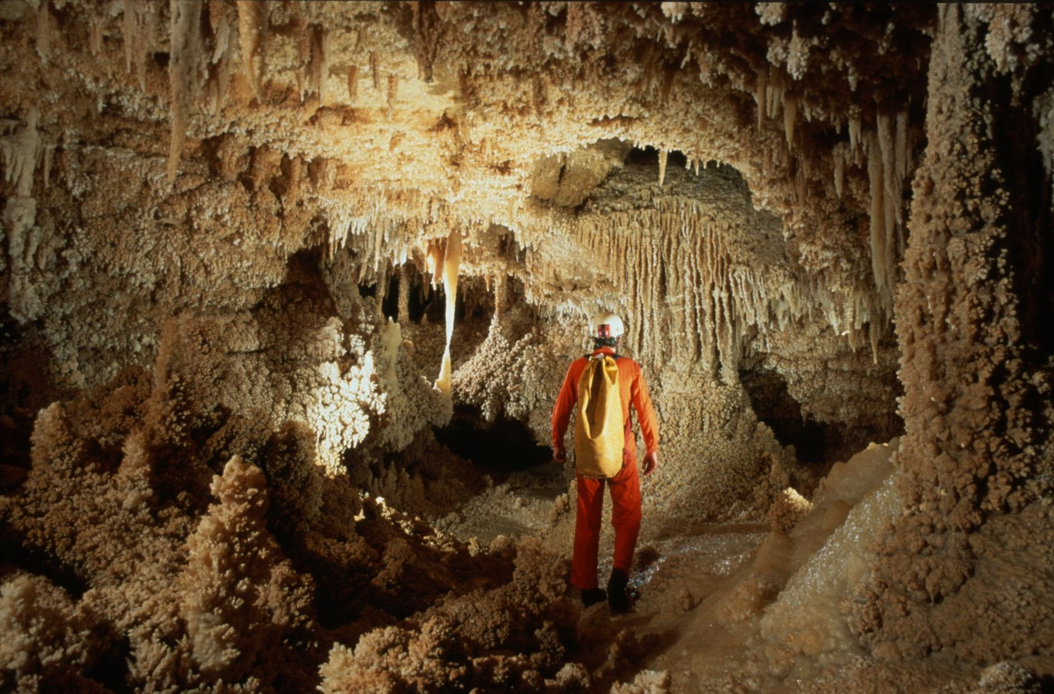
Notes:
Fragile Wonderland - Kevin Downey and Urs Widmer

Slide 29
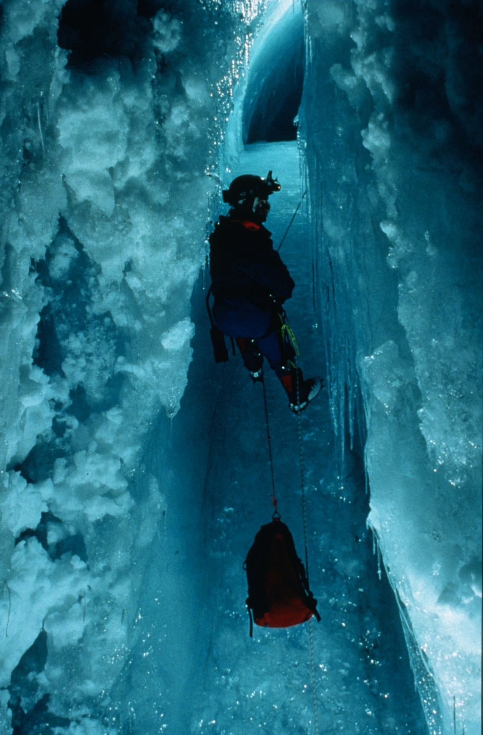
Notes:
L‘Icechuguilla – Marc Tremblay and Diana Gietl

Slide 30
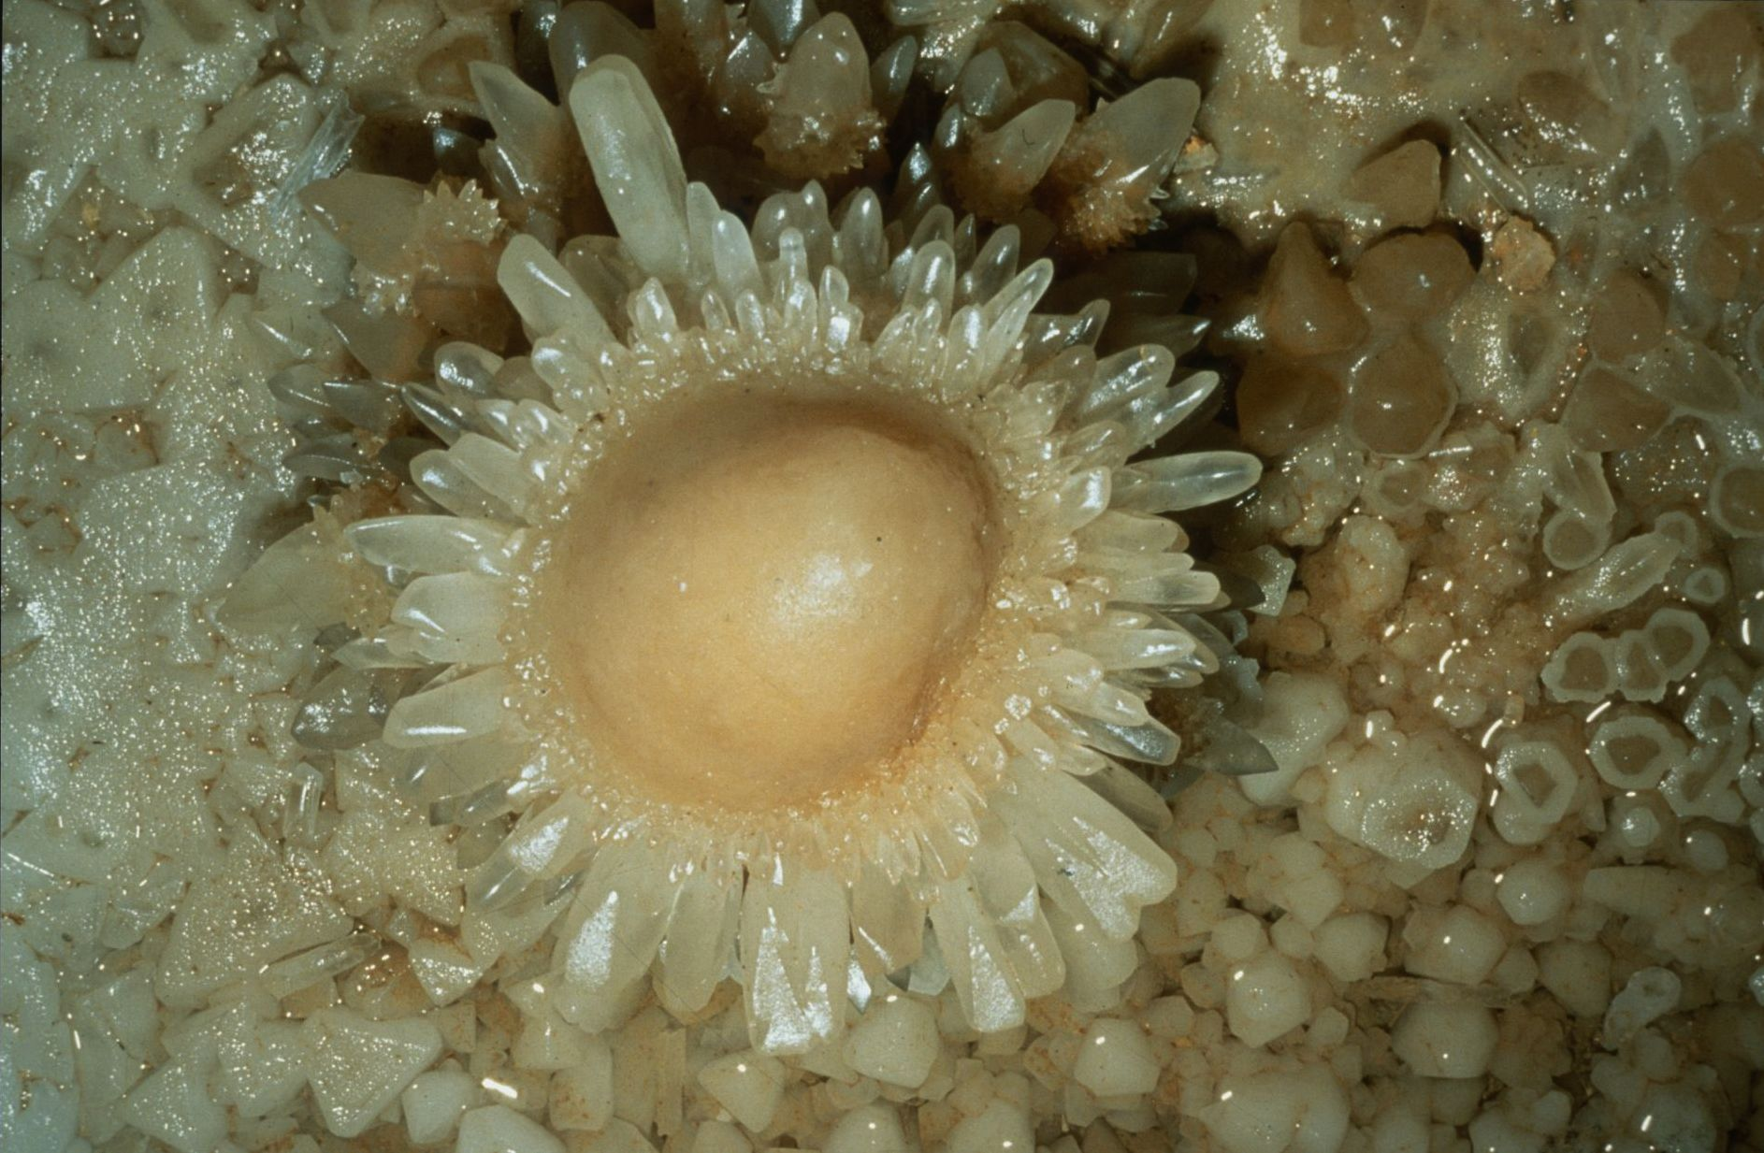
Notes:
Crystal Splatter – Kevin Downey

Slide 31

HONORABLE MENTION
PHOTO SALON

Slide 32
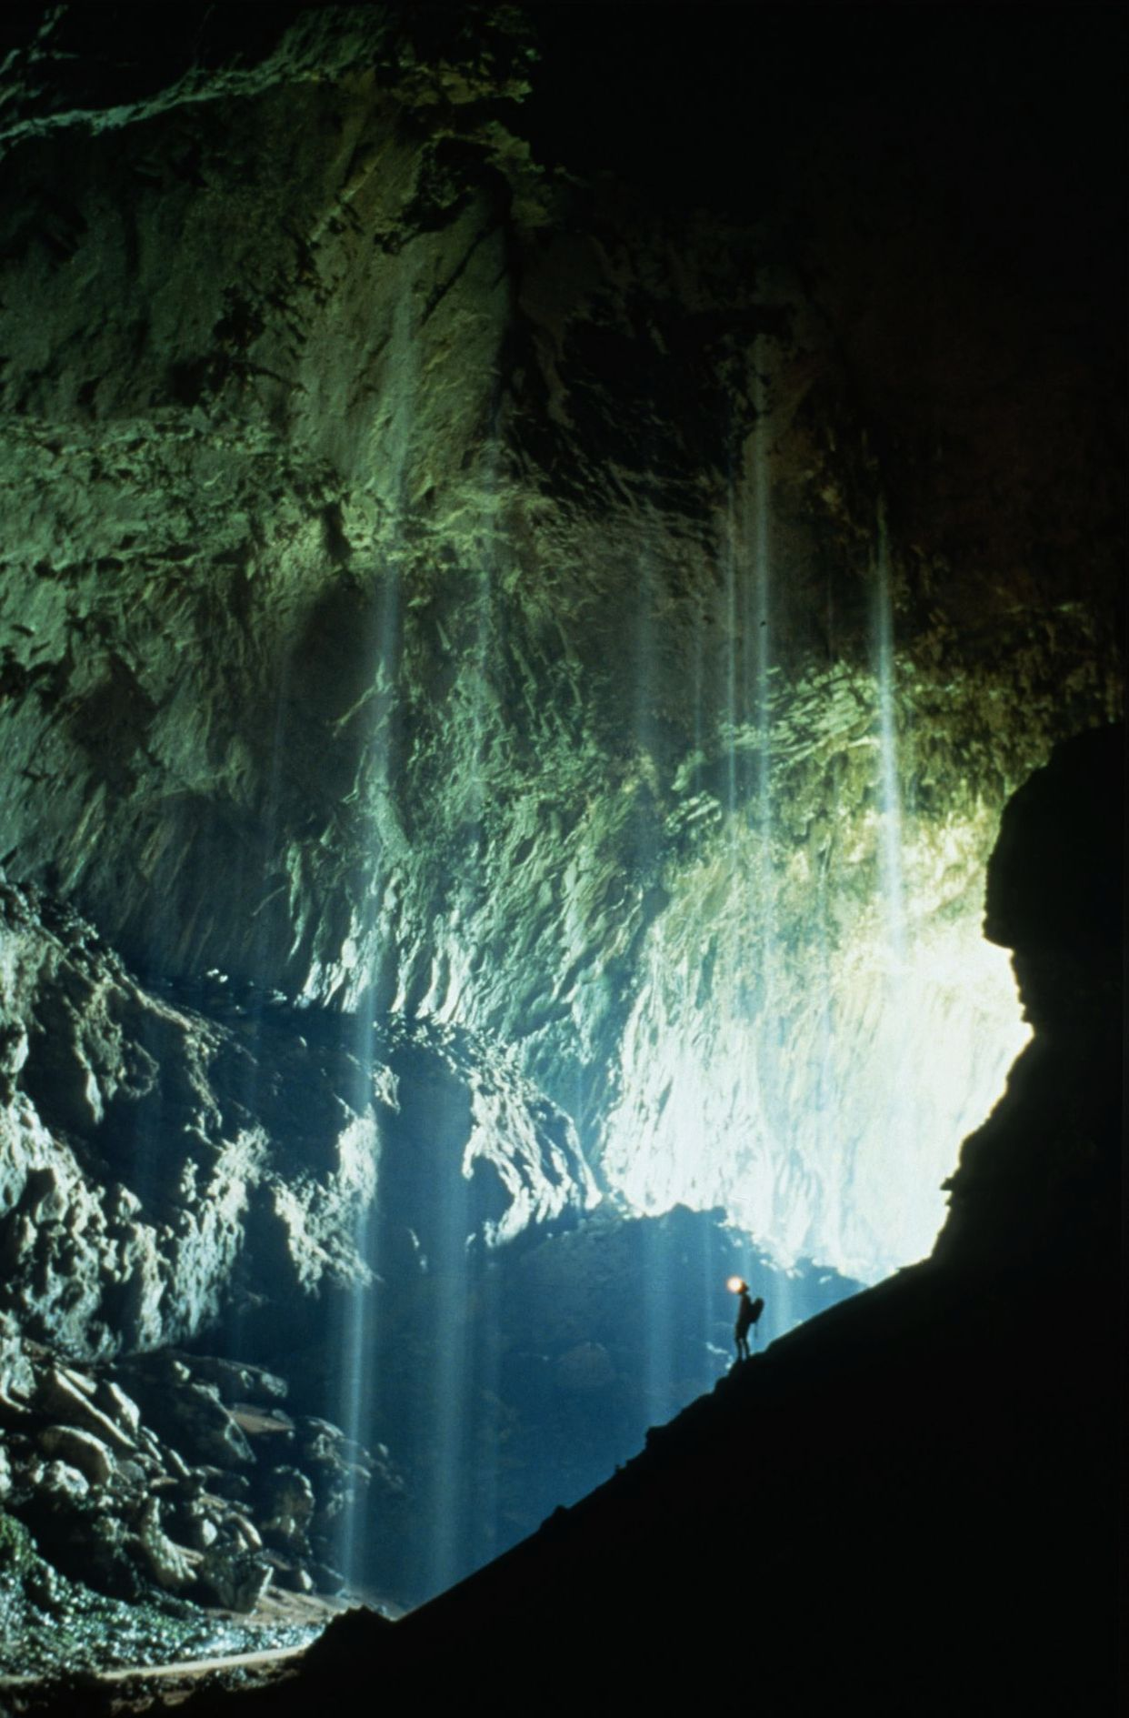
Notes:
The Amazing 500 Foot Waterfalls in Deer Cave Entrance – Kevin Downey

Slide 33
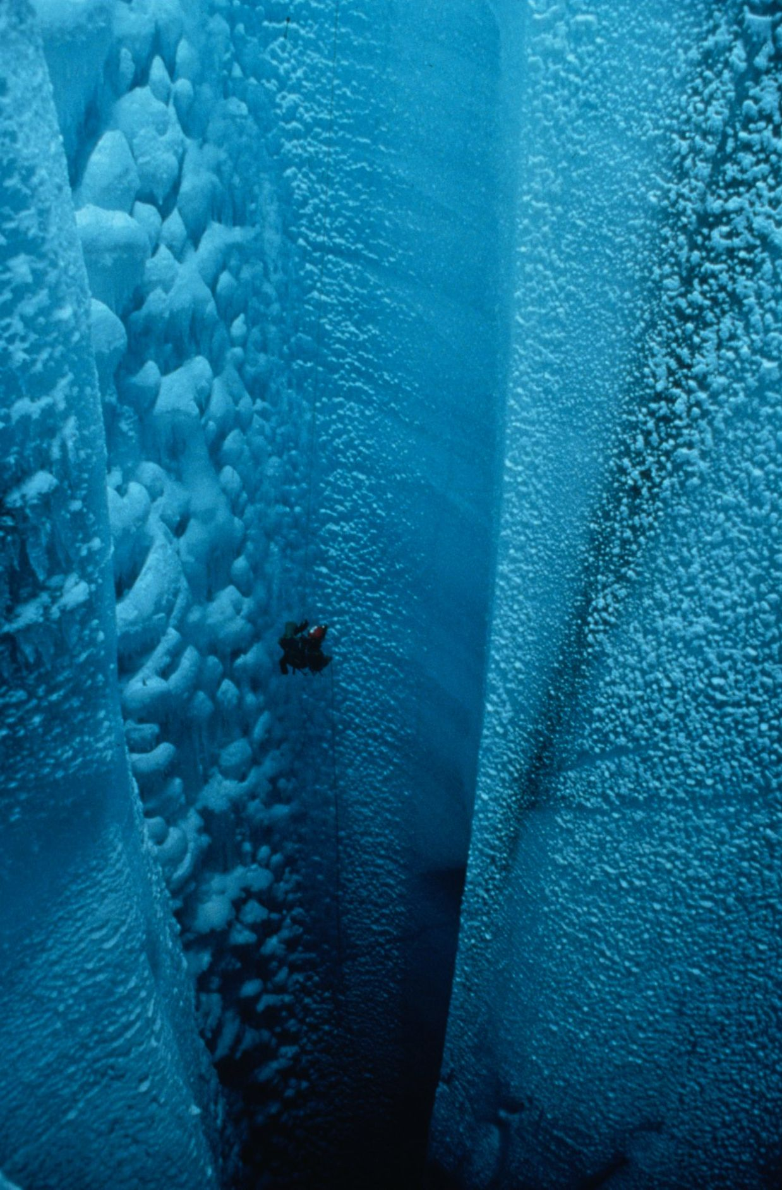
Notes:
Megawell Dubbed in Greenlandish – Marc Tremblay and Diana Gietl

Slide 34
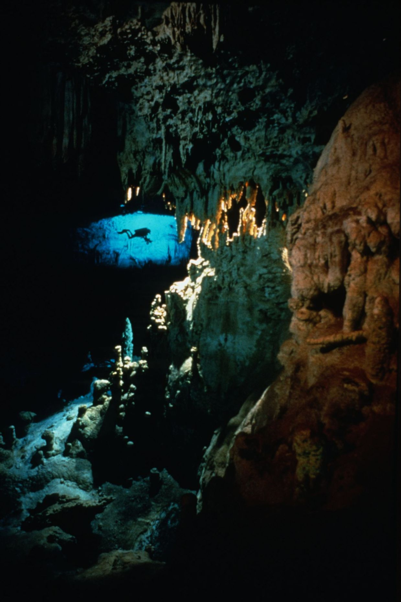
Notes:
Dragon Head - Ron Winiker and Mike Madden

Slide 35
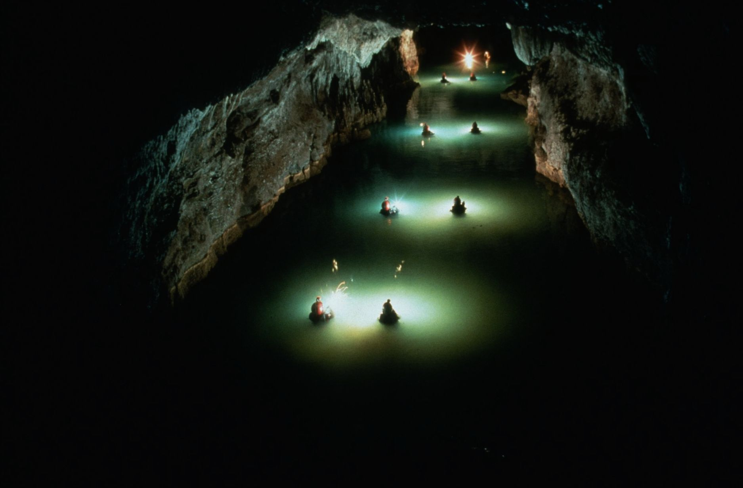
Notes:
Norman’s Lake, Cueva Angels – Kevin Downey

Slide 36
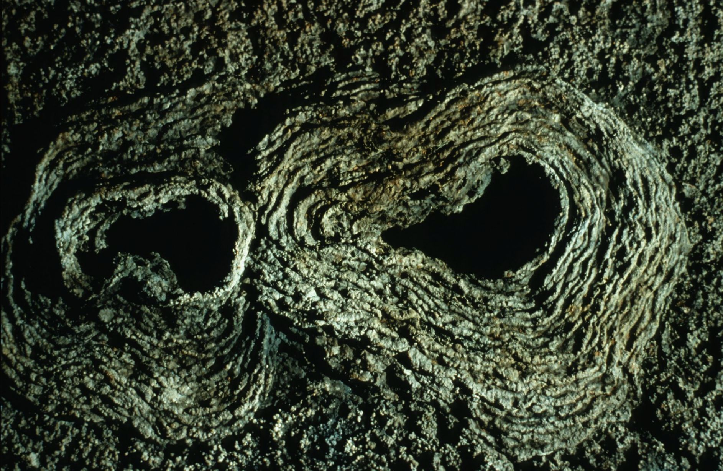
Notes:
Petrified Cow Pies – David Kesner

Slide 37
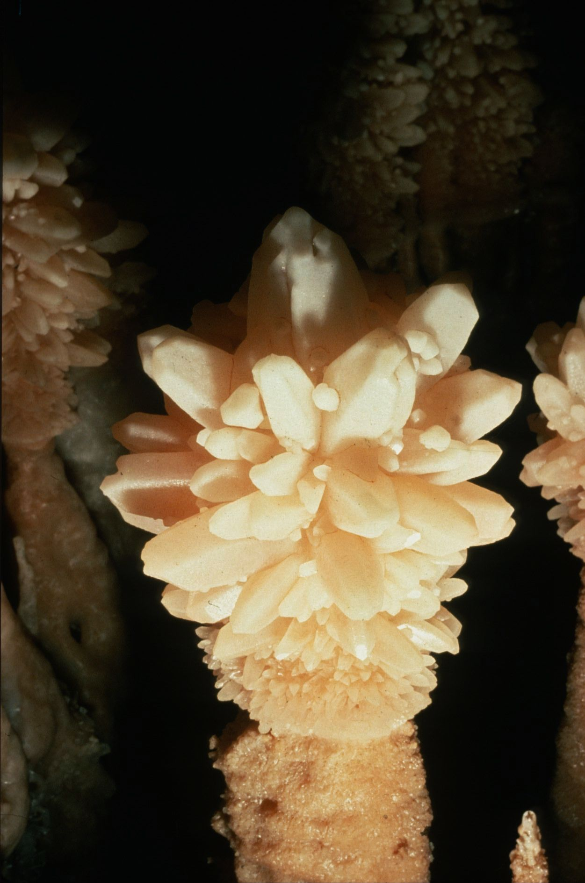
Notes:
Crystal Warclub – Kevin Downey

Slide 38
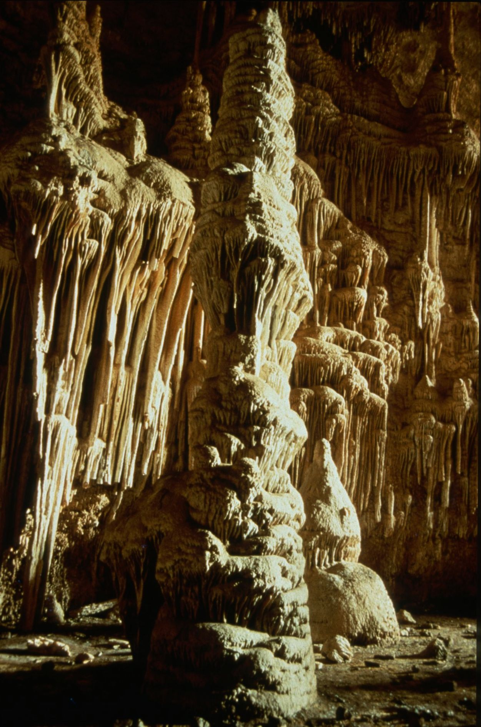
Notes:
Cottonwood by Daylight – Ken Davis

Slide 39
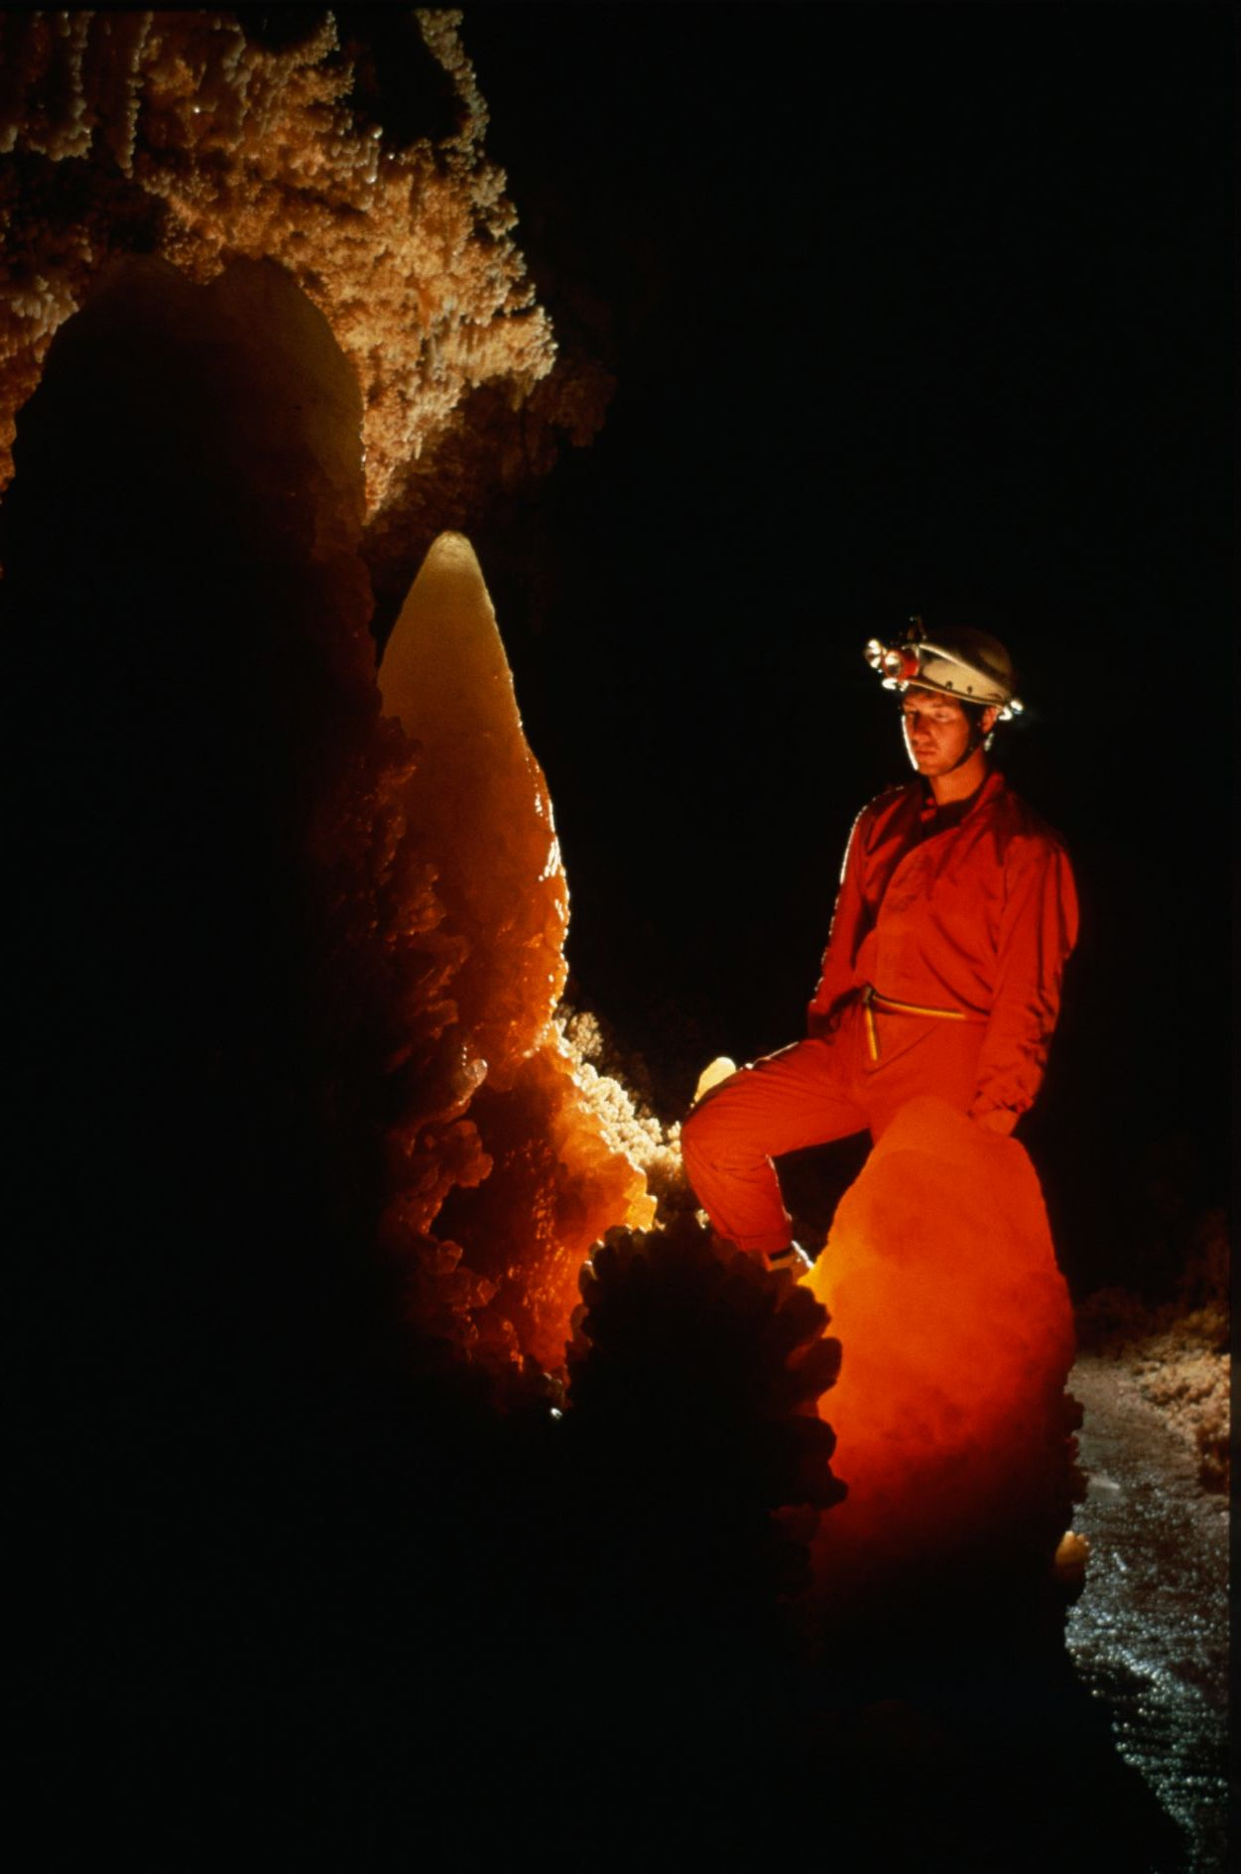
Notes:
Translucent Grace – Kevin Downey and Urs Widmer

Slide 40
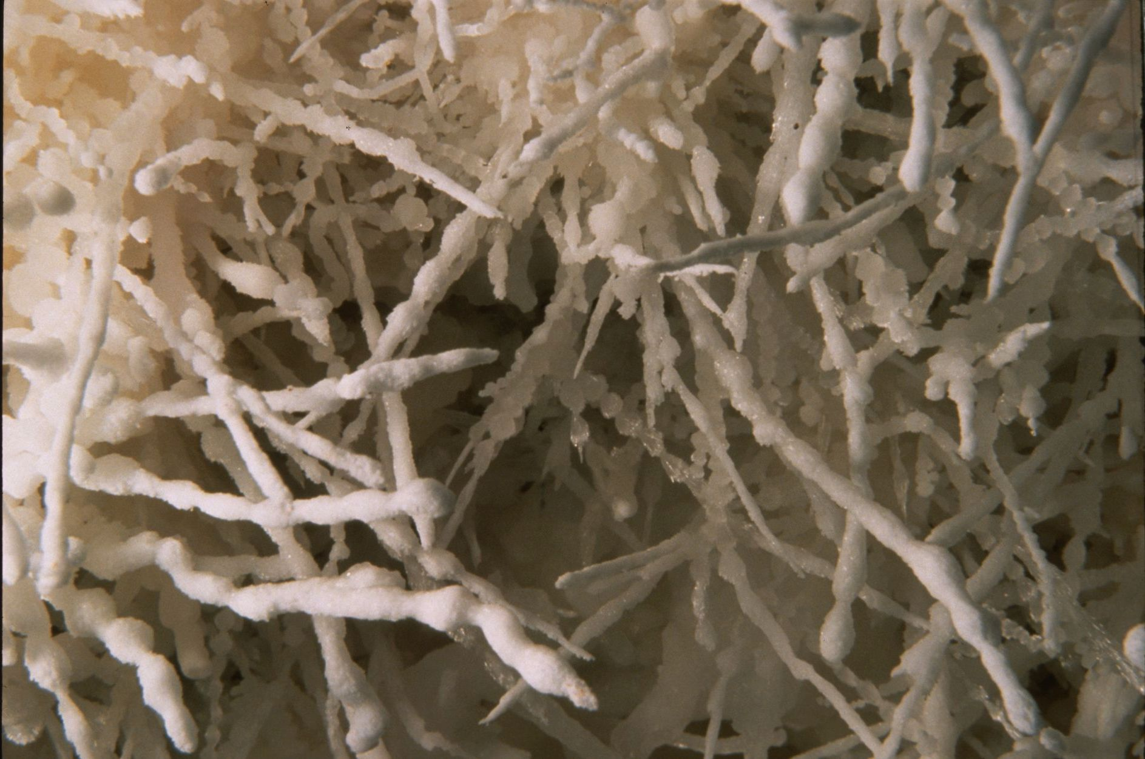
Notes:
Beaded Helictites – David Harris

Slide 41
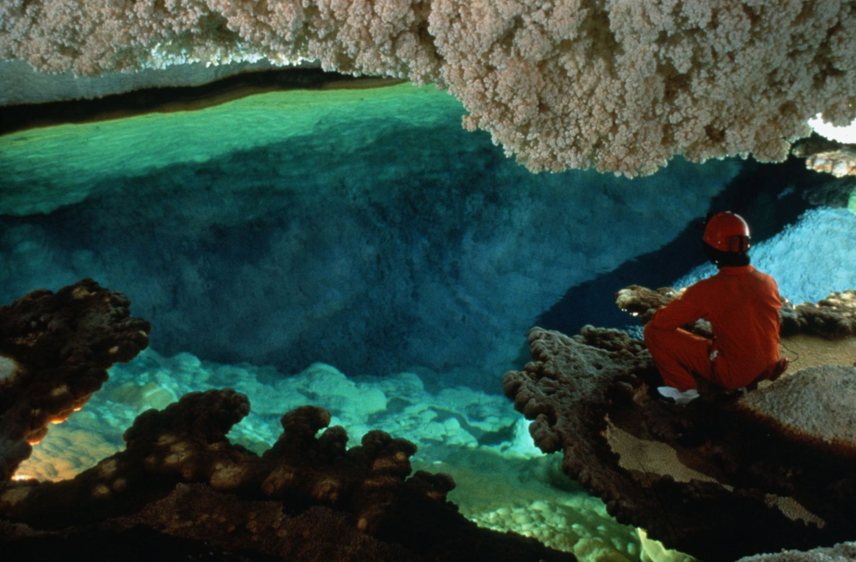
Notes:
Lake of the Giants - Kevin Downey and Urs Widmer

Slide 42
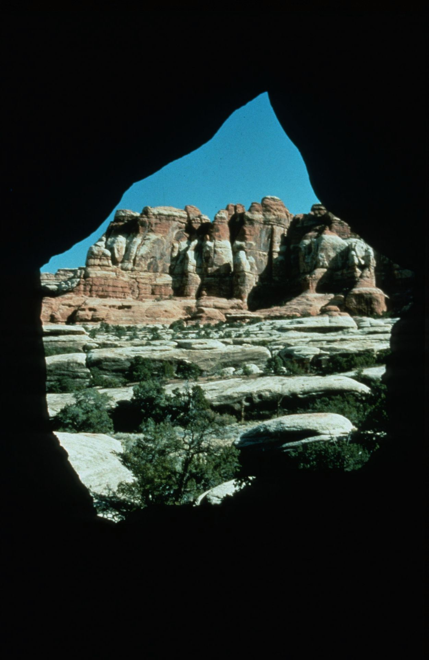
Notes:
Getting into Sandstone – Ken Davis

Slide 43
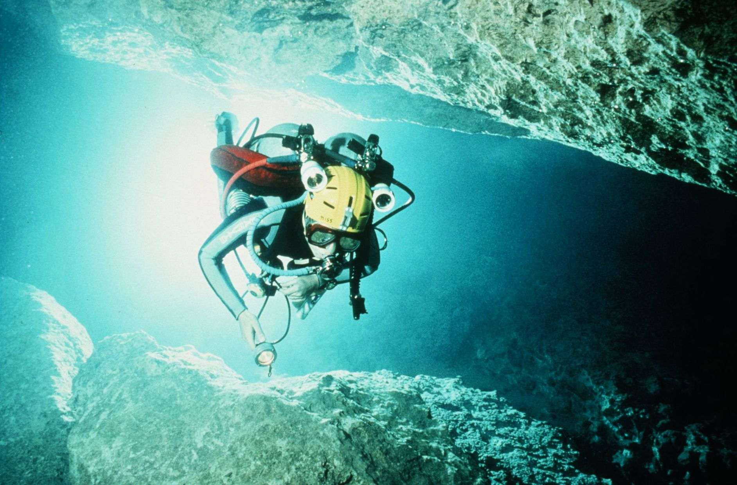
Notes:
Flying Along – Kevin Downey

Slide 44
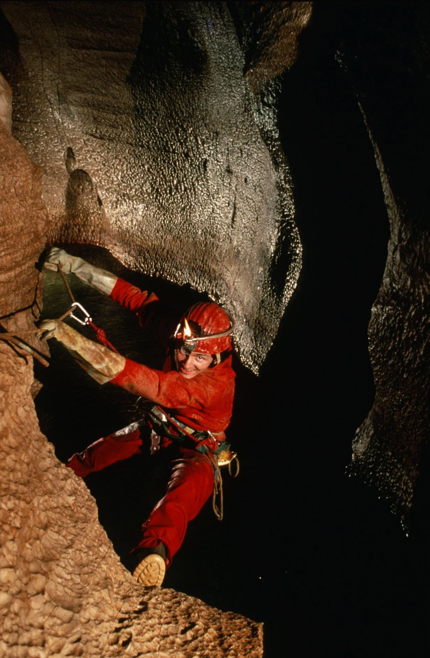
Notes:
Fun! – Peter Bosted

Slide 45
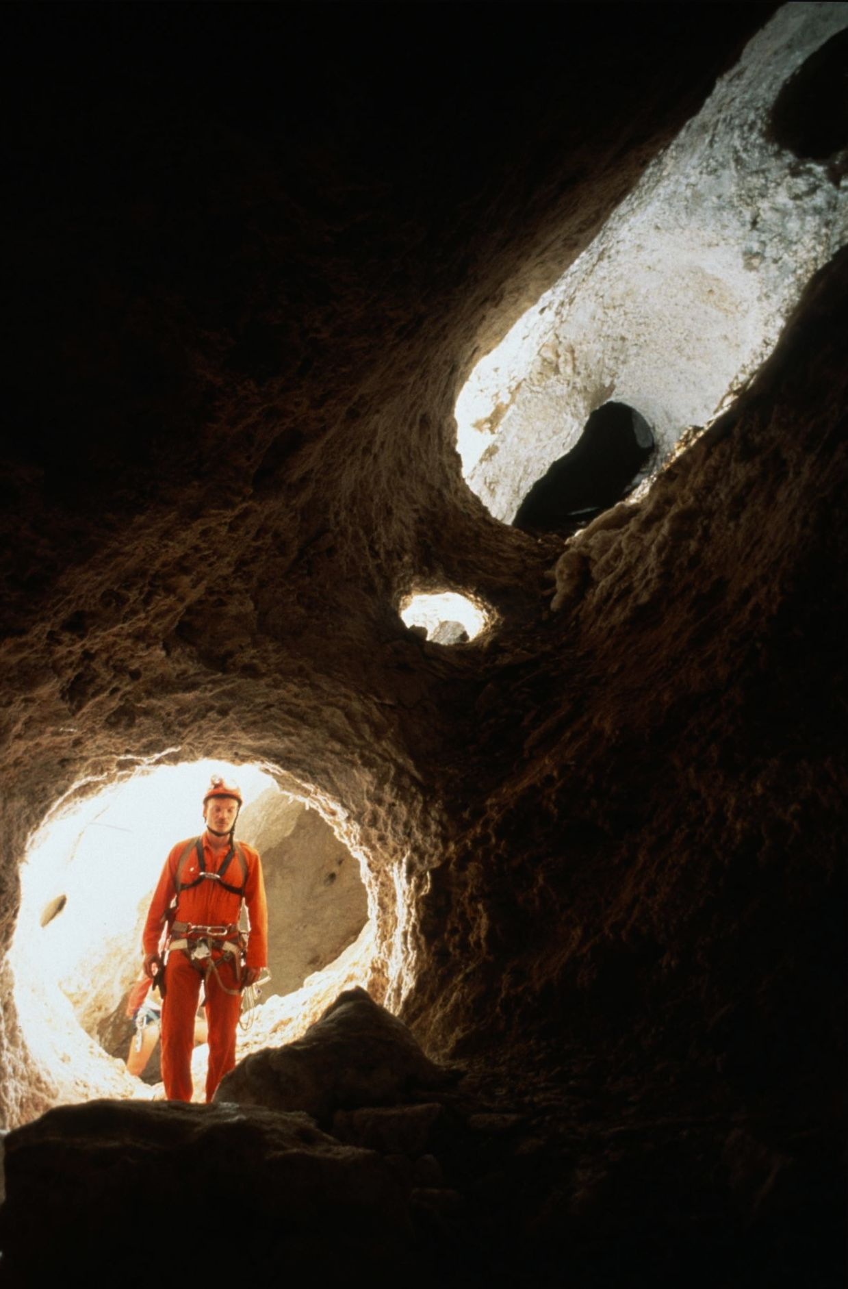
Notes:
Windows of the Northwest Passage - Kevin Downey and Urs Widmer

Slide 46
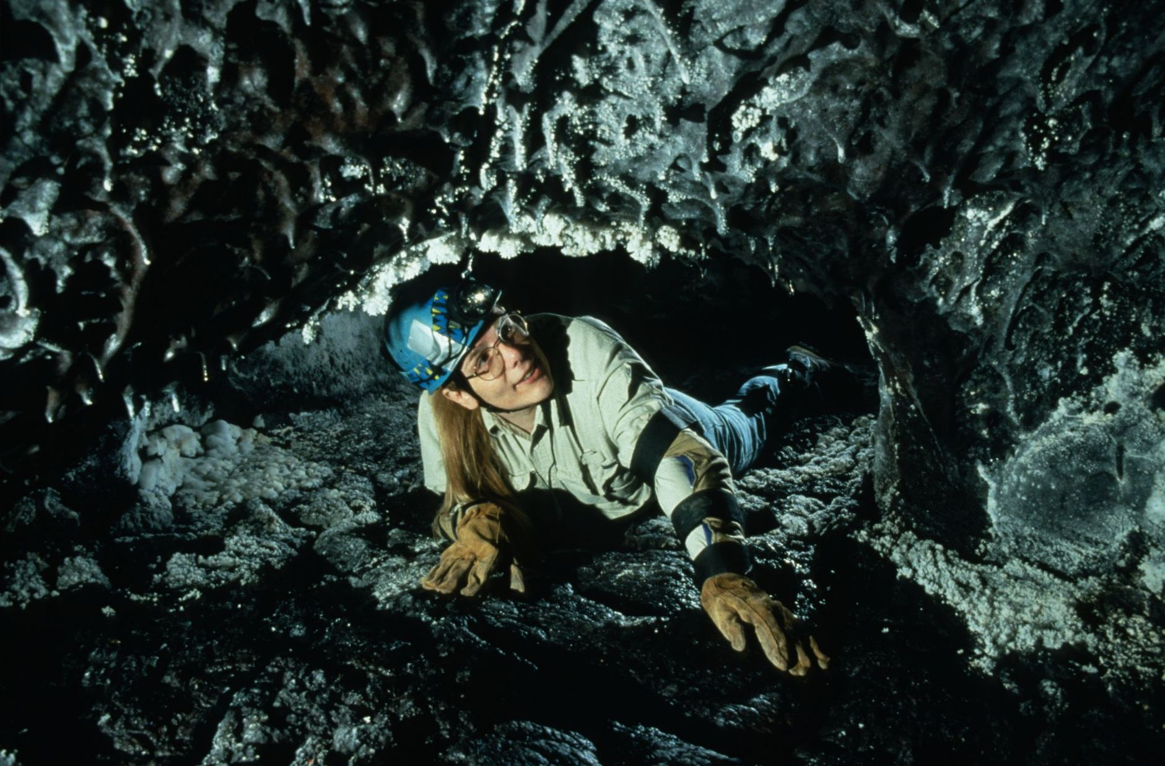
Notes:
Jessica’s Turn – Dave Bunnell

Slide 47
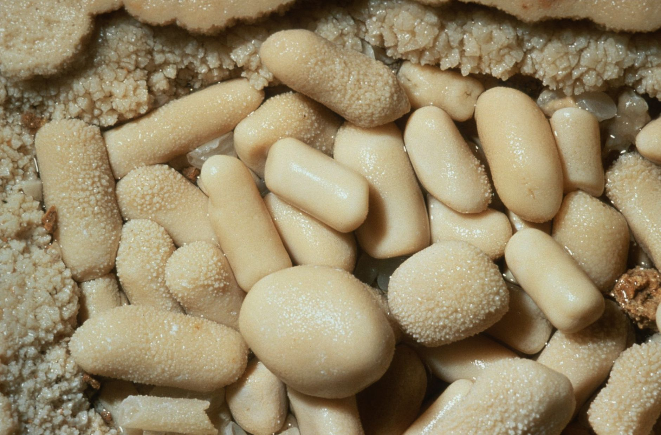
Notes:
Tubular Pearls – Kevin Downey

Slide 48
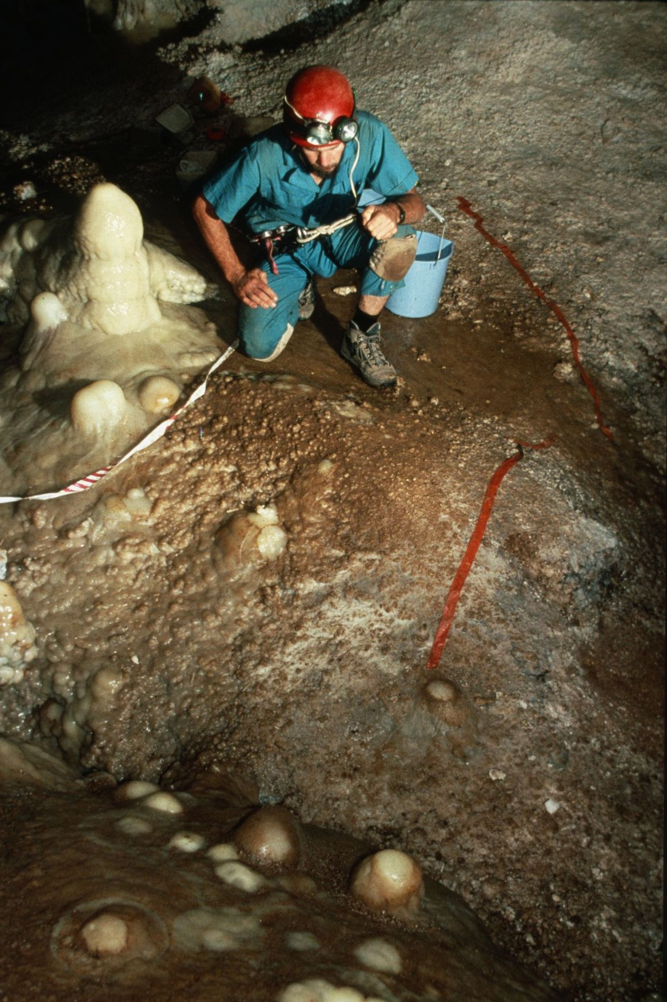
Notes:
Cave Conservation – Before… - Peter and Ann Bosted

Slide 49
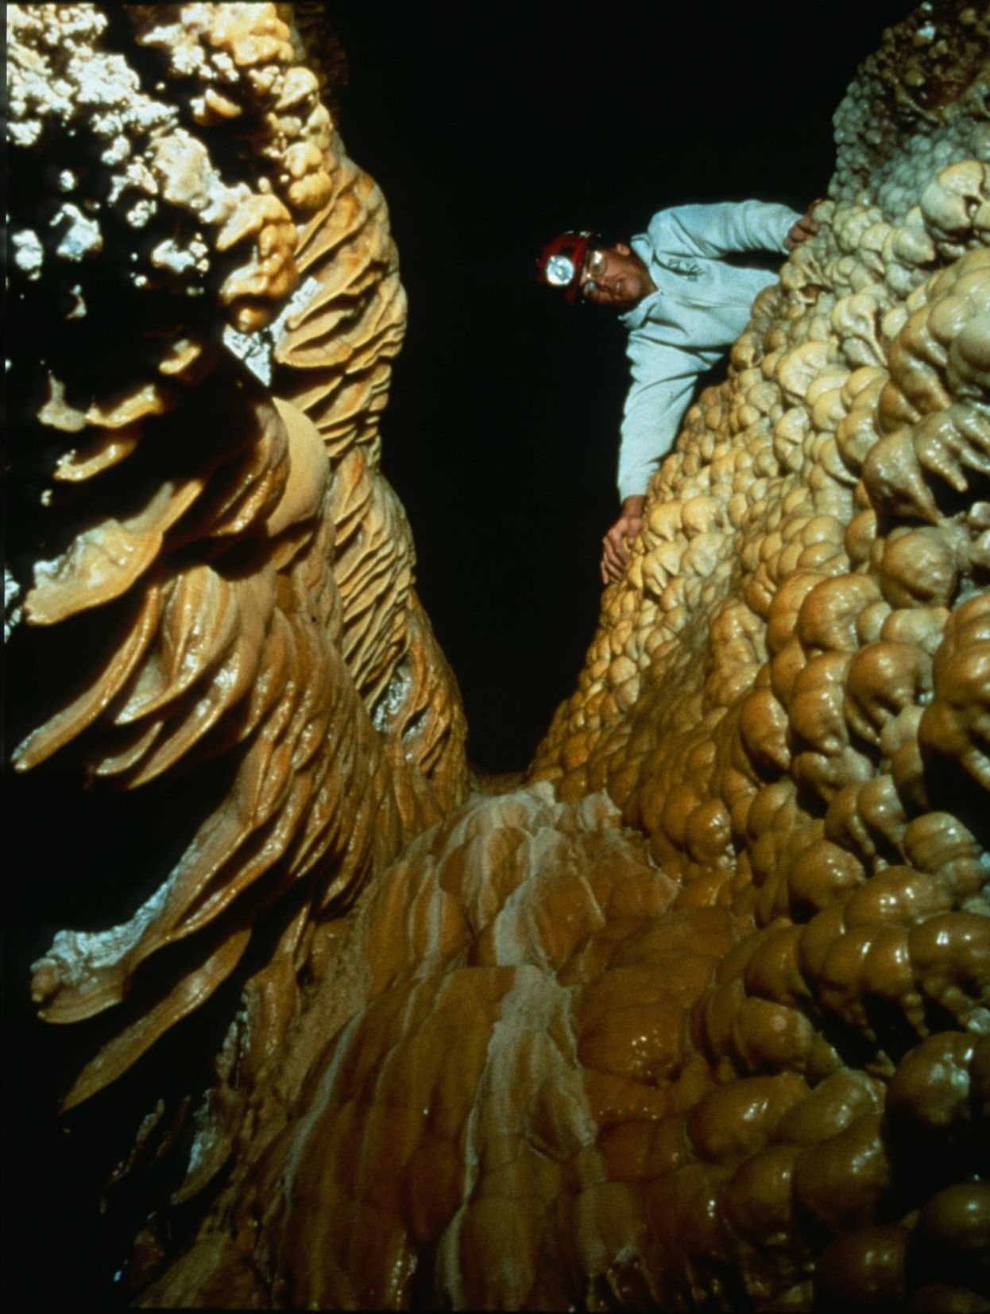
Notes:
Picture Window – Ken Davis

Slide 50
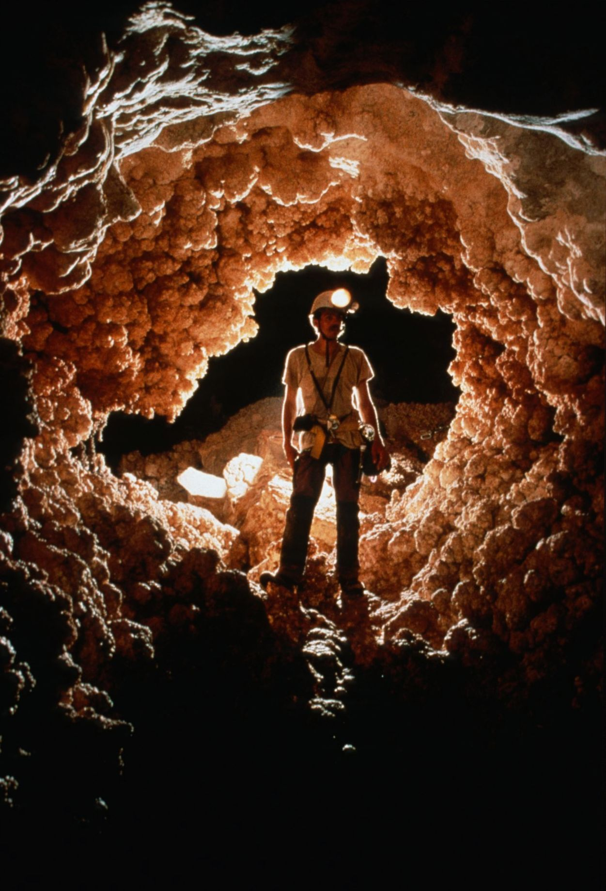
Notes:
An Oasis Under the Desert – Marc Tremblay

Slide 51
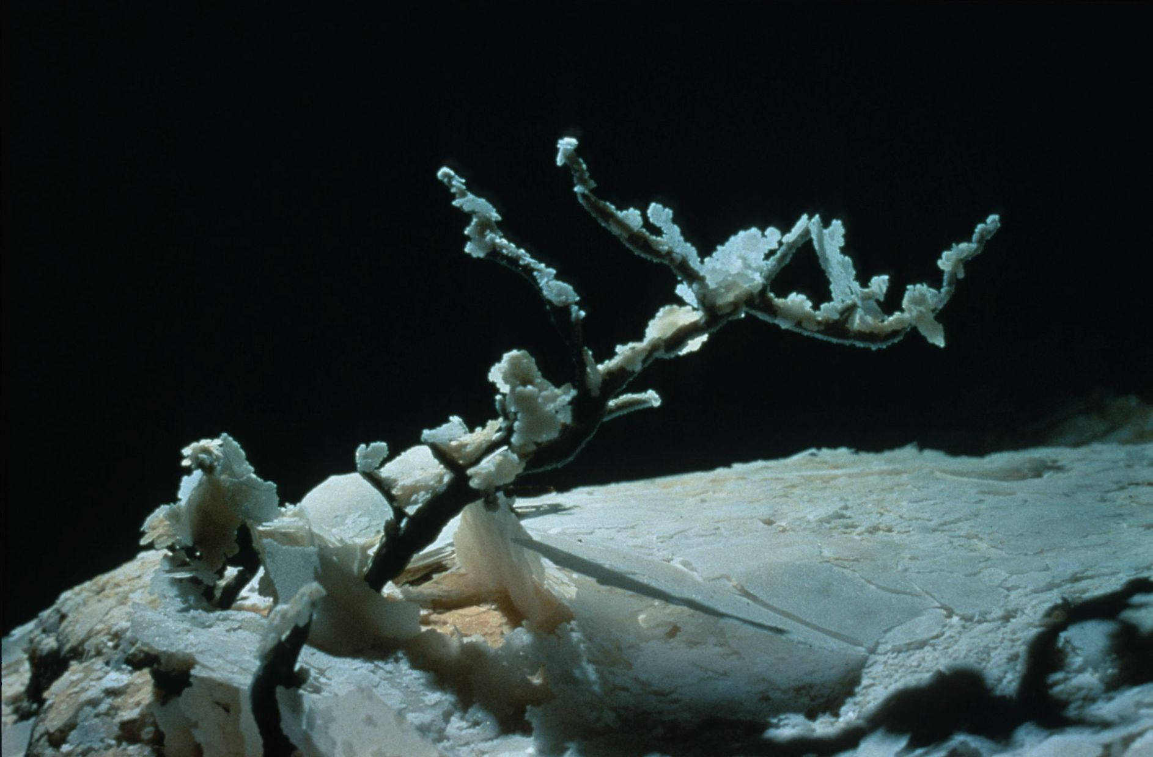
Notes:
Bonsai Tree From the Burnt Forest of Wind Cave - Kevin Downey and Urs Widmer

Slide 52
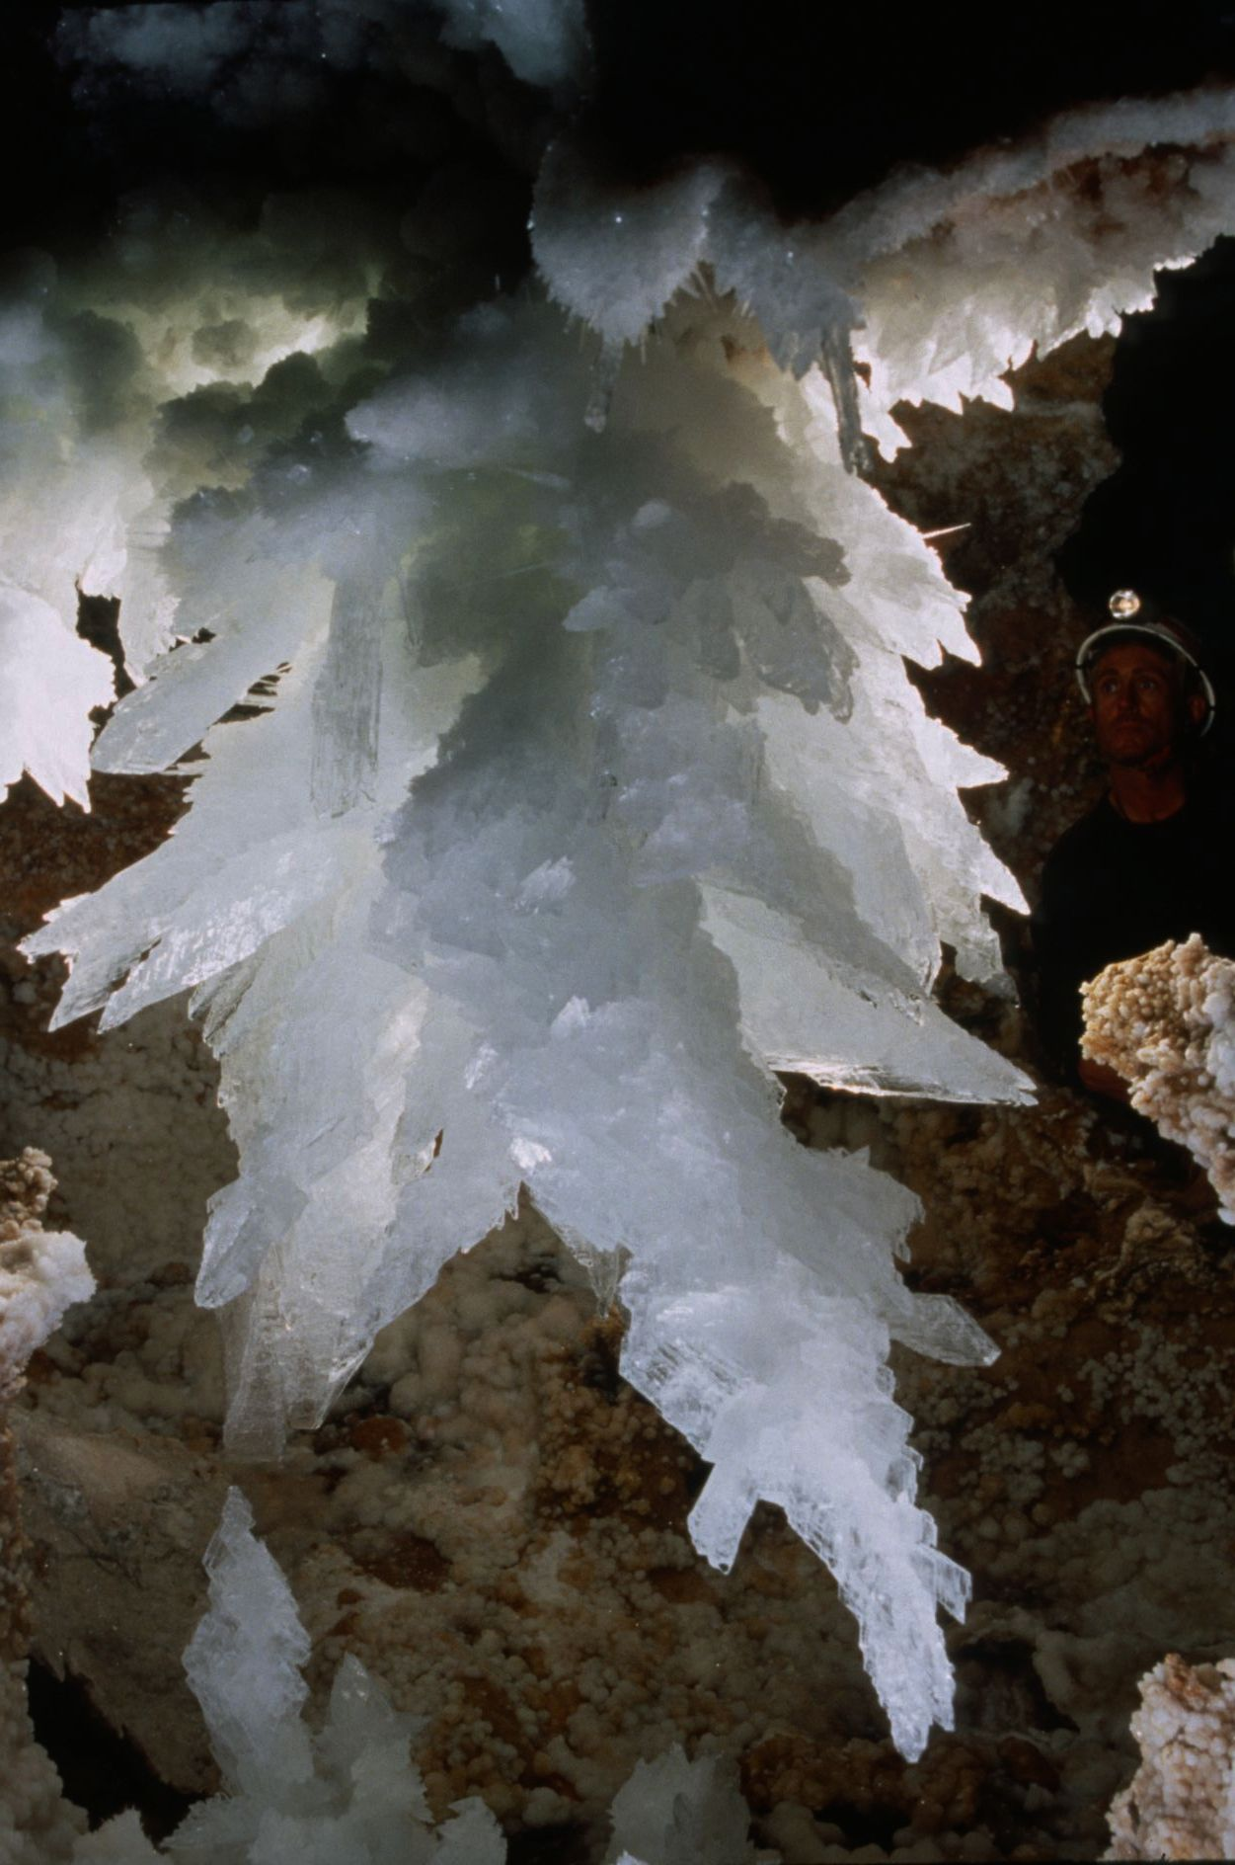
Notes:
In the Jewel Box – David Harris

Slide 53

Notes:
Easy Walking – Peter Jones

Slide 54

Notes:
Calcite Confusion - Kevin Downey and Urs Widmer

Slide 55

Notes:
Phosphorescence – Peter and Ann Bosted

Slide 56

Notes:
Popcorn on Aragonite - Kevin Downey and Urs Widmer

Slide 57

Notes:
Dendritic Pahoehoe – Dave Bunnell

Slide 58

Notes:
Silt Rainbow – Marc Tremblay

Slide 59

Notes:
Out of the Blue – Peter and Ann Boste

Slide 60

Notes:
Steel Points on a Crystal Cylinder – Marc Tremblay and Diana Gietl

Slide 61

Notes:
Blobs - Kevin Downey and Urs Widmer

Slide 62

MERIT AWARD
PHOTO SALON

Slide 63

Notes:
Argo Well, Montemayor – Dave Bunnell and Djuna Bewley

Slide 64

Notes:
Spar Flower – Kevin Downey

Slide 65

Notes:
On the Outskirts – Peter and Ann Bosted

Slide 66

Notes:
Apricots and Aragonite - Kevin Downey and Urs Widmer

Slide 67

Notes:
Caving by Air and Water – Peter and Ann Bosted

Slide 68

Notes:
Huntsman Spider Waiting on a Good Hand Hold – Kevin Downey

Slide 69

Notes:
The Phoenix – David Harris

Slide 70

Notes:
In the Heart of the Helectite Hall - Kevin Downey and Urs Widmer

Slide 71

Notes:
Anti-Gravity Caving Suit – Marc Tremblay

Slide 72

Notes:
Parallel Universe Inside Gunong Buda – Kevin Downey

Slide 73

Notes:
The Tesla Coil Group – David Harris

Slide 74

Notes:
Opposite Forces – Ramon Quintana

Slide 75

Notes:
“Boots-Off” Nightmare – Dave Bunnell

Slide 76

Notes:
Follow the Water – David Harris

Slide 77

BEST OF SHOW
PHOTO SALON

Slide 78

Notes:
Dropping the Big One – Dave Bunnell

Slide 79
Photographers

Slide 80
Photographers
  Djuna Bewley
  Peter and Ann Bosted
  Dave Bunnell
  Ken Davis
  Kevin Downey
  Collin Gatland
  Diana Gietl
  David Harris
  Peter Jones
  Mike Madden

Slide 81
Photographers
  Ed McCarthy
  Gary Phelps
  Ramon Quintana
  Carl Samples
  Marc Tremblay
  Richard Vernier
  Urs Widmer
  Ron Winiker

Slide 82

An NSS Audio-Visual Library Presentation
The Best of the
1995 NSS Photo Salon
Original slide program S919
Slides digitized by David Caudle
PowerPoint program created by Jim McConkey
82 slides, with script in presenter notes
PowerPoint created 3/09/2021
National Speleological Society
6001 Pulaski Pike
Huntsville, AL 35810-1122
256- 852-1300
nss@caves.org
https://caves.org/

